Slide 1



PHASE 1 FINAL
DESIGN REVIEW PRESENTATION
Team 520 PC
Prepared for:
EML 4551 Senior Design I
AUTOMATIC DOG DOOR
Notes:
Add the title of the project

Slide 2





MEET THE TEAM
Aaron Burghardt
Mandolin Brown
Jack Smith
Matthew Thompson
Software Engineer
Project Engineer
Design/Materials Engineer
Parts Engineer
Notes:
Maybe add Sponsors & Advisors?

Slide 3
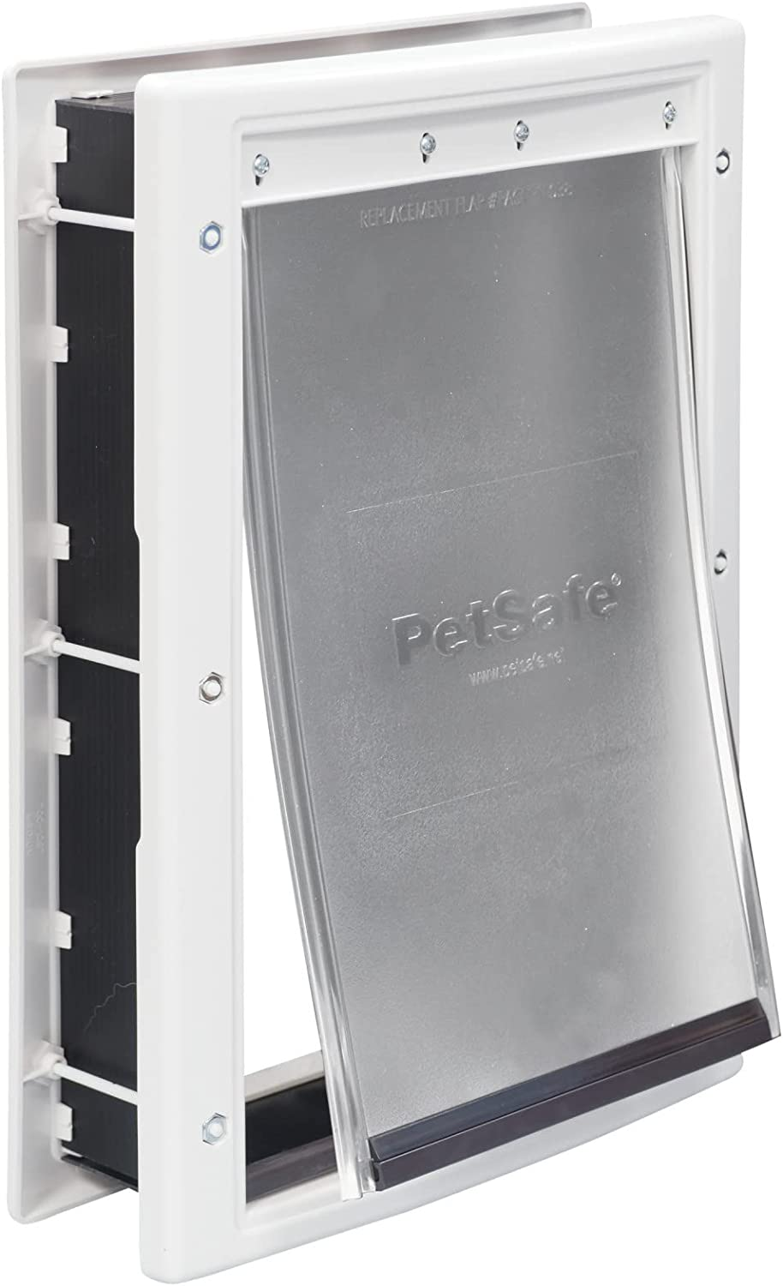
PROJECT BACKGROUND
Traditional dog doors have faults
Unlimited access
  Dogs roam freely from exterior to interior
  Dogs track mud, water, and dirt into home
  Causes interior property damage
Lack of security
  Unwanted animals/persons entering home
  Pets exiting home against owner’s desire
  Children/toddlers exiting home via dog door
Traditional Dog Door
(installed in door or wall)
Source: amazon.com
Notes:
ADD PICTURE EARLY ON
Our senior design project is focused on homeowners who own pets and specifically dogs
We are targeting homeowners who integrate dog doors into their homes for the care and convenience of their pets
You could lock the door and keep dogs outside when guests are over? But the whole concept is more useful as a remote access application

Slide 4
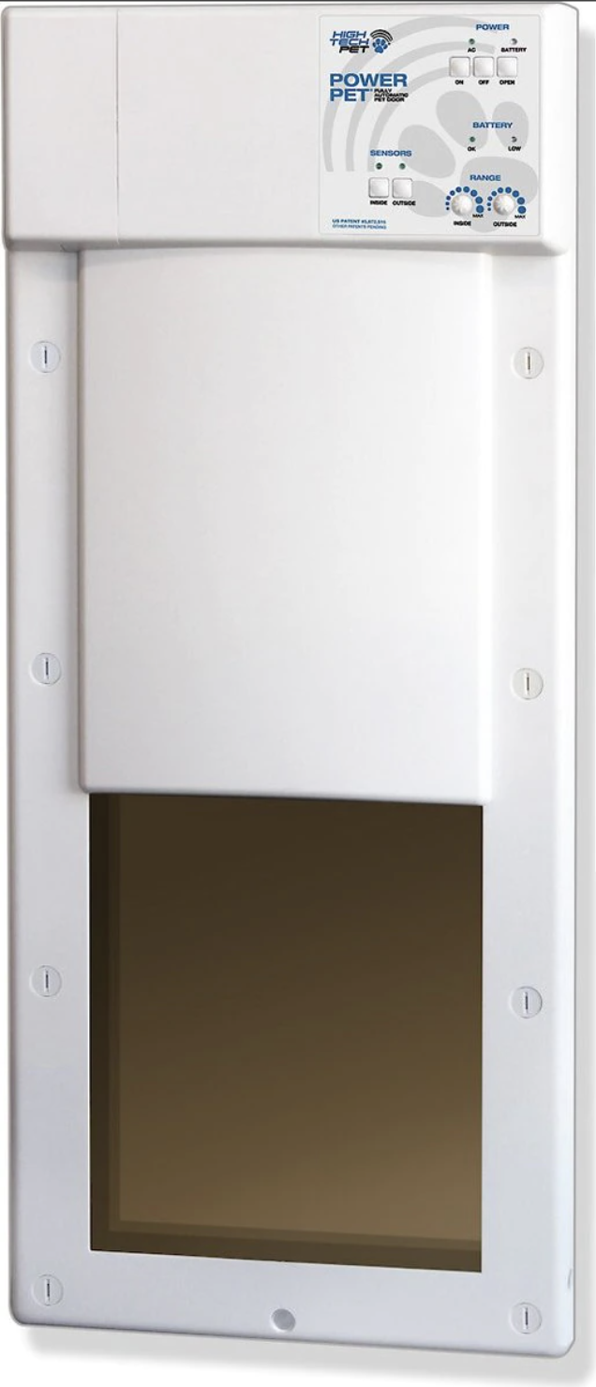
PROJECT BACKGROUND
Electronic dog doors currently exist on the market
Customers report recurring issues
  Poor battery life on dog door
  Poor battery life on dog collar
  Issues controlling door remotely
    (App functionality and connectivity problems)
Electronic Dog Door
(installed in door or wall)
Source: chewy.com
Notes:
ADD PICTURE EARLY ON
Note that rfid tag can last indefinitely unlike ultrasonic door
DON’T RAMBLE
THIS IS WHAT IS CURRENT IN THE MARKET, WE EVALUATED WEAKNESSES IN PRODUCTS THAT ARE CURRENTLY ON MARKET

Slide 5
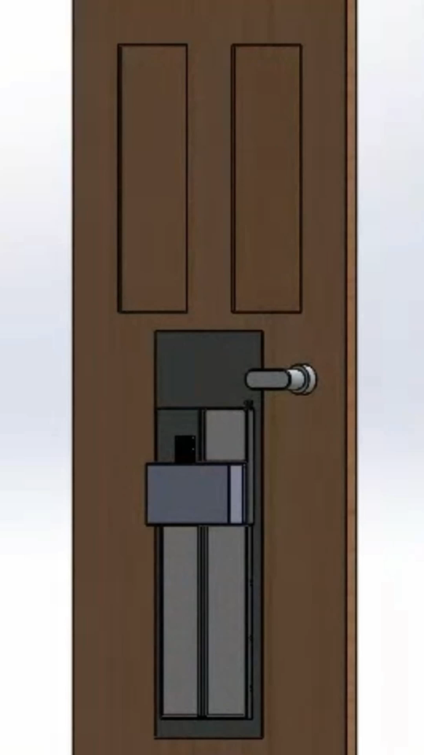
OUR PROJECT PROPOSAL
PROJECT DESCRIPTION
Automated dog door that can be controlled remotely to limit access to a home’s interior or exterior based on constraints such as time of day or inclement weather predictions
PROJECT INSPIRATION
Desire to limit and control pet access through home interior and exterior
Notes:
ADD PICTURE EARLY ON

Slide 6
OUR PROJECT PROPOSAL
PROJECT OBJECTIVES
Design dog door that will automatically open and close on command
Design door to sense when dog is approaching and open/close if door is unlocked or stay closed if locked Provides limited access
Sense if obstruction is blocking door from opening or closing
Provides safety measure
Notes:
ADD PICTURE EARLY ON

Slide 7
OUR PROJECT PROPOSAL
PROJECT GOALS
Allow consumer to control locking function remotely
Control locking mechanism based on meteorological data, time, and distance
Allow proximity/sensitivity adjustment for sensors on interior and exterior of door
Track number of pets in interior and exterior of residence
Notify consumer if obstruction is blocking door
Notes:
ADD PICTURE EARLY ON

Slide 8
PROJECT PHASE 1: EML 4551 SENIOR DESIGN 1
  Project topic selection
  Benchmarking/topic research
  Concept generation
  Concept selection
  Concept design
  Part selection
  Finalization of preliminary concept design
  Finalization of BOM and cost estimate
  Planning and projected dates
Phase 1 Design Review 1
2/20/23
Phase 1 Intermediate Design Review
4/5/23
Phase 1 Final Design Review
4/21/23
Notes:
Note that this phase lasts from January 2023 to April 2023
Ending on the day of the presentation
TALKED A LOT ON THIS SLIDE BUT IT LOOKS NICE

Slide 9
TARGETS AND METRICS
Function | Metric | Target
Cost | Price of Materials and Production | < $2,000
Size | Area of Door Opening | 19” x 11”
Response to Data Input | Unlock Speed | < 1 second
Response to Data Input | Door Open Speed | < 3 seconds
Safety | Sense Door Obstruction | ✅ / ❌
Remote Capability | Website/App Operable | ✅ / ❌
Limited Accessibility | Accept/Decline Signal | ✅ / ❌
Notes:
ADD PICTURE EARLY ON
**running off of AC power, plug into wall, define battery as “future work” for reliability/lifespan: batter life
TARGETS AND METRICS: GOOD SLIDE
Need more constraints??
Fix calculations for response to data input SPEEDS: refer to Aarons initial calculations maybe have a calculation slide in back just for the speed numbers

Slide 10
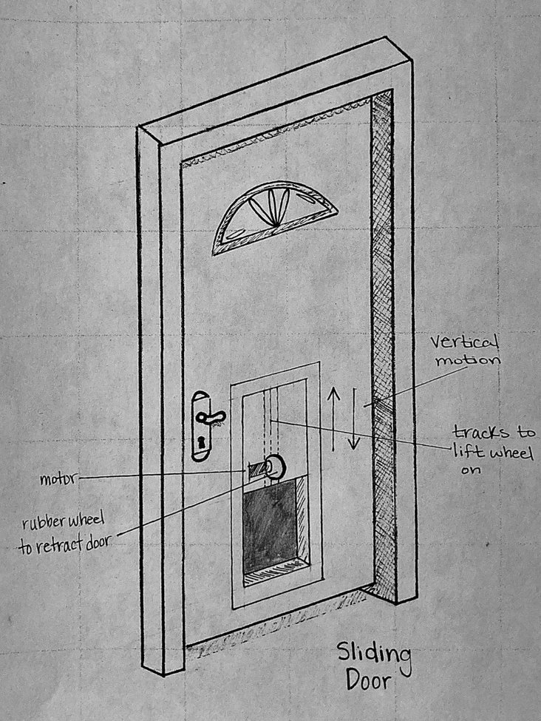
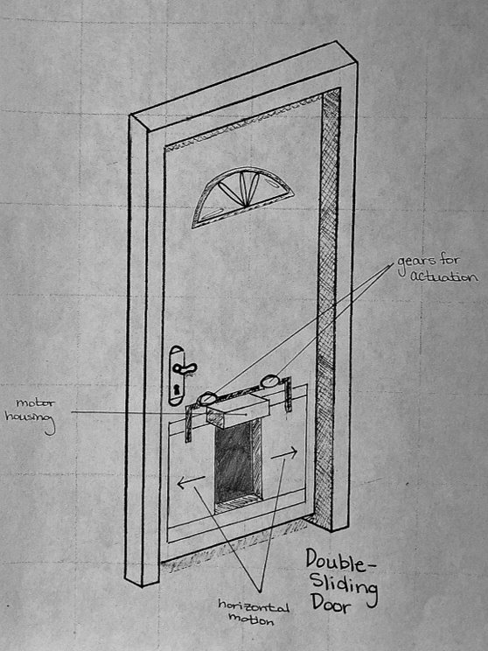
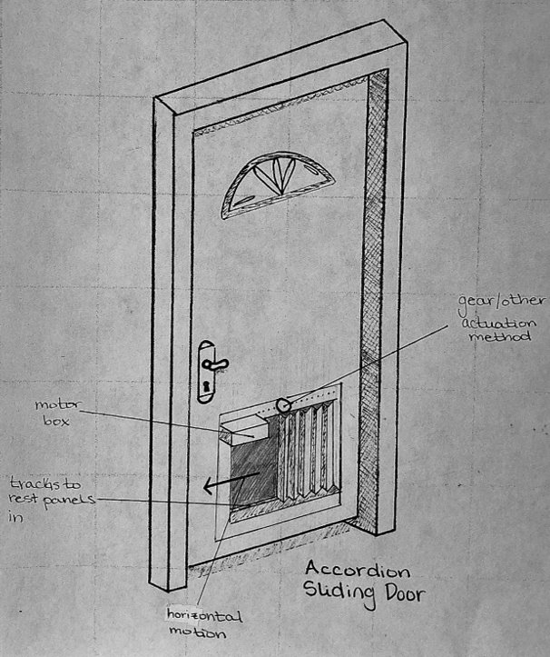
CONCEPT GENERATION
Concept 2
Horizontal Sliding Door
Concept 3
Accordion Folding Door
Concept 1
Vertical Sliding Door
Notes:
Use examples
(2nd one: use garage door for example and stuff like this)

Slide 11
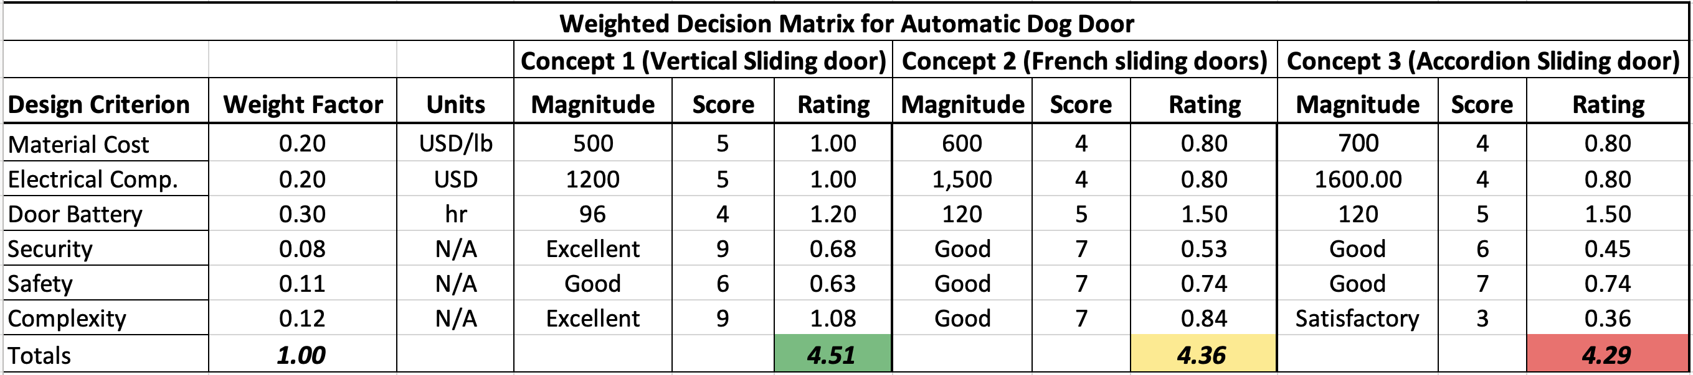
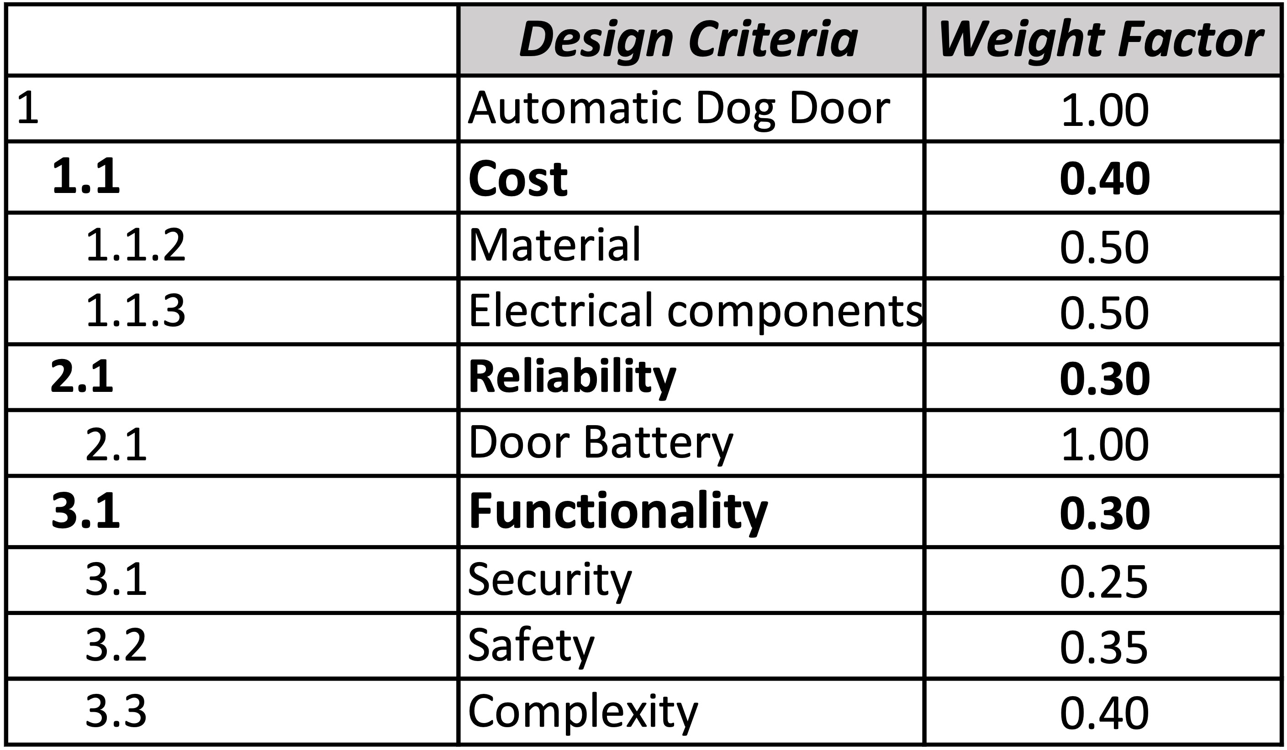
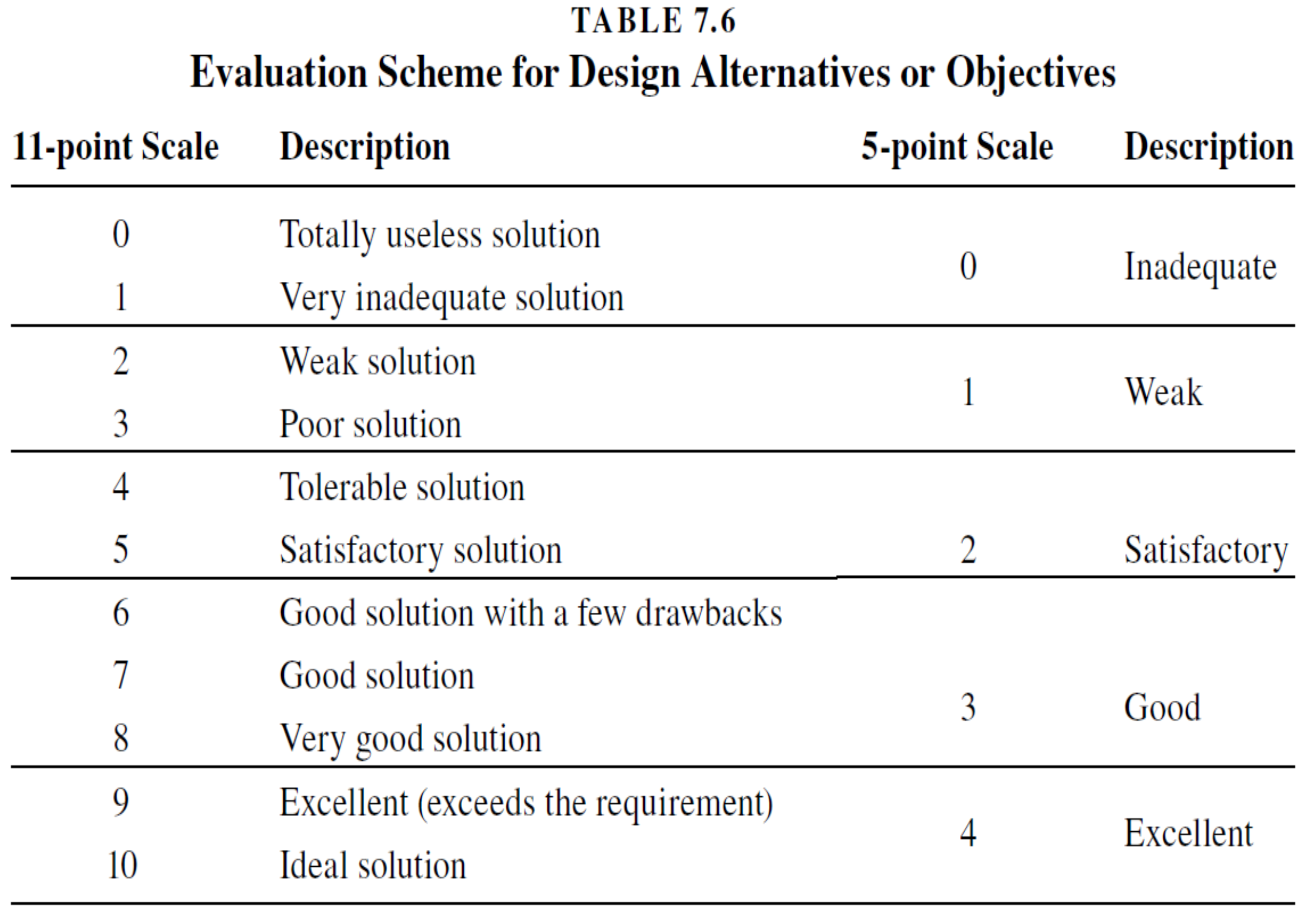
DECISION MATRIX
Selected
Design
Criteria
Design Criteria
Scoring Key^{[1]}
Notes:
Mandolin is button clicker, aaron explain scoring criteria

Slide 12
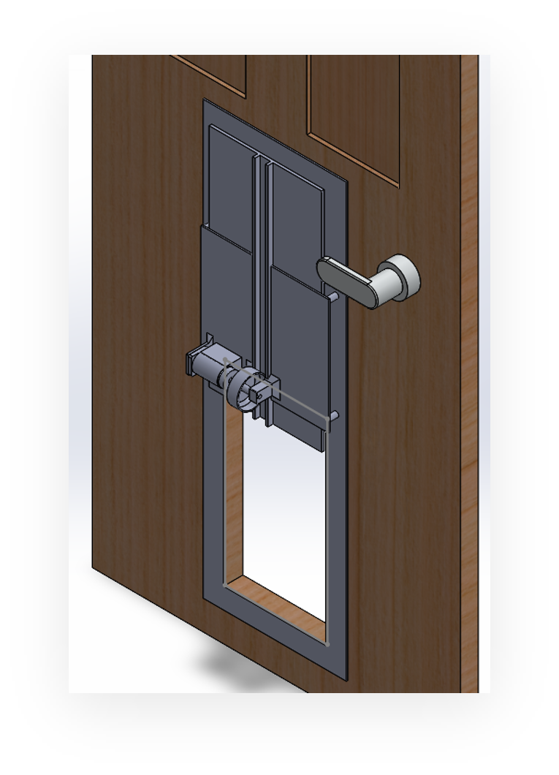
SELECTED CONCEPT
Preliminary concept sketch
Vertical sliding door concept
  Initially preferred concept
  Highest ranking in weighted decision matrix
Best factors of design:
  Low complexity
  Ample security/reliability
Initial 3D model
Notes:
fine

Slide 13
STATE DIAGRAM OF SYSTEM
PERMANENTLY LOCKED
NO ACTION
INCLEMENT WEATHER DETECTED
USER-DEFINED LOCK STATE
INCLEMENT WEATHER (LOCKED)
TAG DETECTED
CHECK WEATHER
FAIR WEATHER DETECTED
ACCESS WITH RFID TAG (UNLOCKED)
TAG DETECTED
OPEN DOOR
TOP SENSOR HIT /
5 SECOND DELAY
CLOSE DOOR
CHECK
OBSTRUCTION
N/A
OBSTRUCTION DETECTED
BOTTOM SENSOR HIT

Slide 14
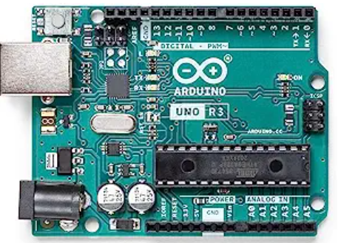
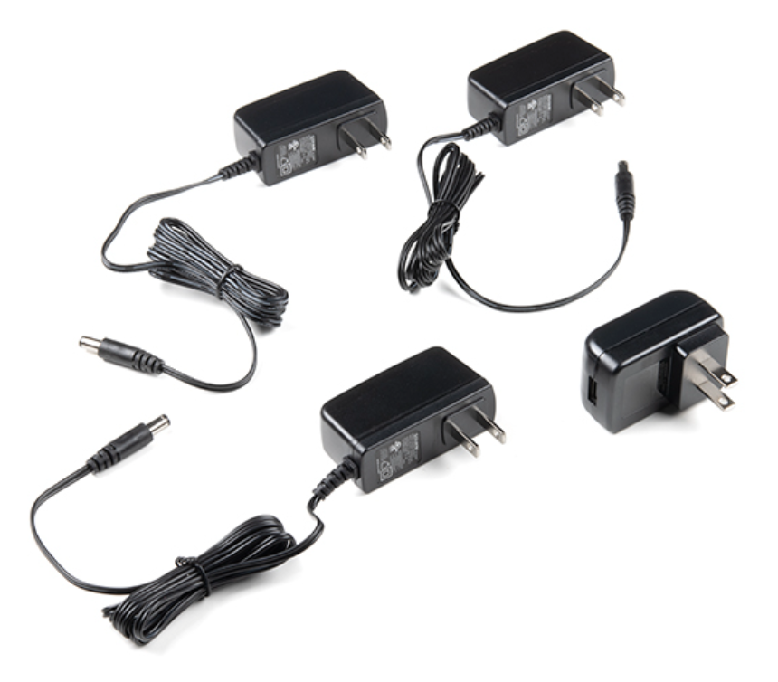
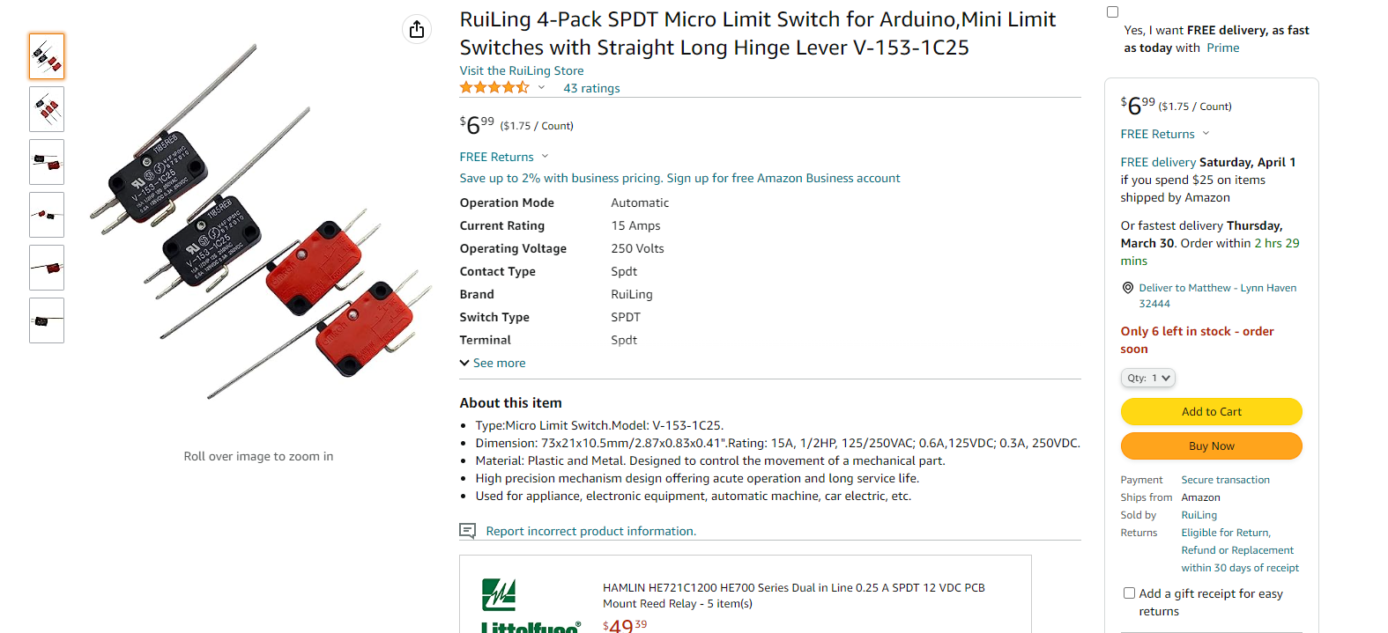
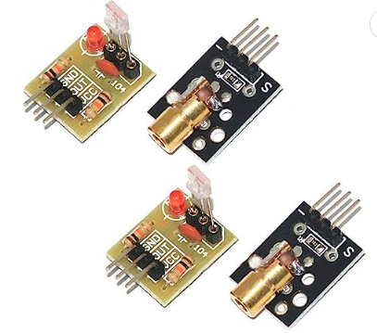
ELECTRONIC HARDWARE COMPONENTS
Microcontroller
  Arduino Uno WiFi Rev2
  Software will monitor and control all electrical components
Power
  AC plug for Arduino, RFID reader, and motor
Sensors
  Microswitch: detect door position
  Laser / Photo Resistor Sensor: detect door obstruction
Microcontroller
AC plug
Microswitch
Photoresistor
Notes:
Why did we choose AC plug instead of battery?
DON’T TALK ABOUT BATTERY
Say that we might include battery testing later on

Slide 15
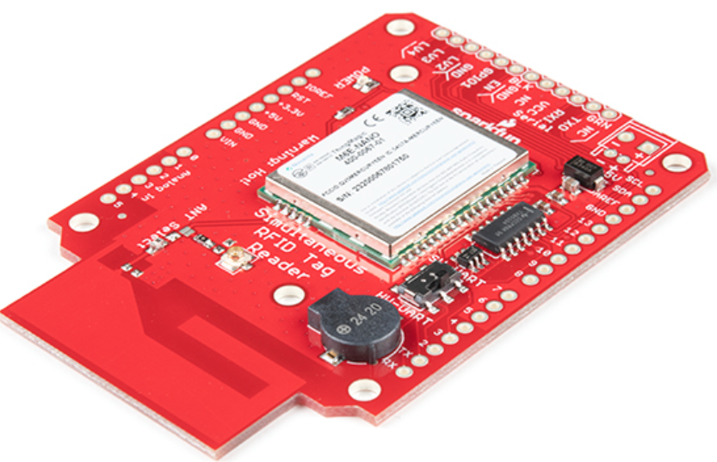
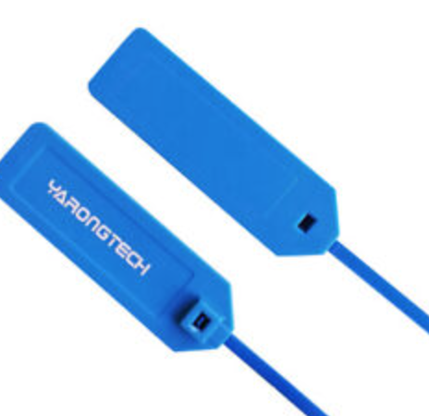
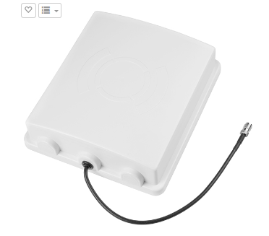
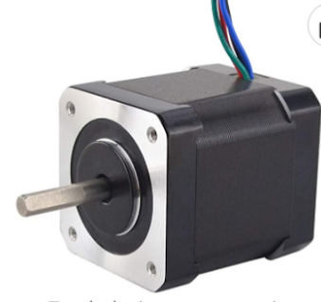
ELECTRONIC HARDWARE COMPONENTS CONT.
UHF RFID (ultra-high frequency radio frequency identification)
Reader: SparkFun - M6E Nano
  Compatible with Arduino
Antenna – UHF RFID
  Up to 16’ detection range
UHF RFID compatible tag
  No internal battery required
Motor
  Stepper motor, lifts/closes door
RFID Reader
RFID Tags
RFID Antenna
Motor
Notes:
INCLUDE RFID ACRONYM WHAT DOES IT STAND FOR??
Make sure you say that we are going to have 3 sensors, do not say we will have SOME sensors
Put analogy to explain rfid sensing like the clothes tag on

Slide 16
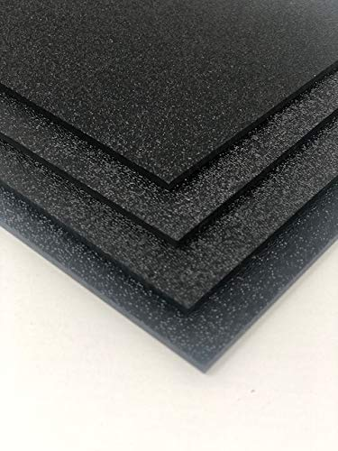
MATERIAL SELECTION AND JUSTIFICATION
FOR DOG DOOR FRAME:
Acrylonitrile Butadiene Styrene (ABS) plastic
  Tough thermoplastic material
  High impact strength
  Lightweight
  Suitable for exterior conditions
  Cost effective
  Utilized by competitor models
    Safe to use
ABS Plastic Sheet
Notes:
add numbers talked about on slide, density cost ect.
add sutable for exterial, sun exposer and weather ect. (enviroments consideration)
comparing weight with something known for audience
Explain thermoplastic qualities (such as deformation temps)​
add numbers talked about on slide, (density of ABS vs. Other material such as steel or aluminum)​
Add specific cost for ABS ($30 per 12" x"24".25" sheet)​
Talk about corrosion more, and talk about coefficient of thermal expansion value... explain if it would work well in both southern and northern climates​
add suitable for exterior, sun exposure and weather etc. (enviroment consideration)​
comparing weight with something known for audience ​
Discuss more about competitor models and that they also selected ABS plastic. This shows that this is reputable and valid choice for safety, calculations, environmental concerns, etc.​
Talk about temp concerns of material​

Slide 17
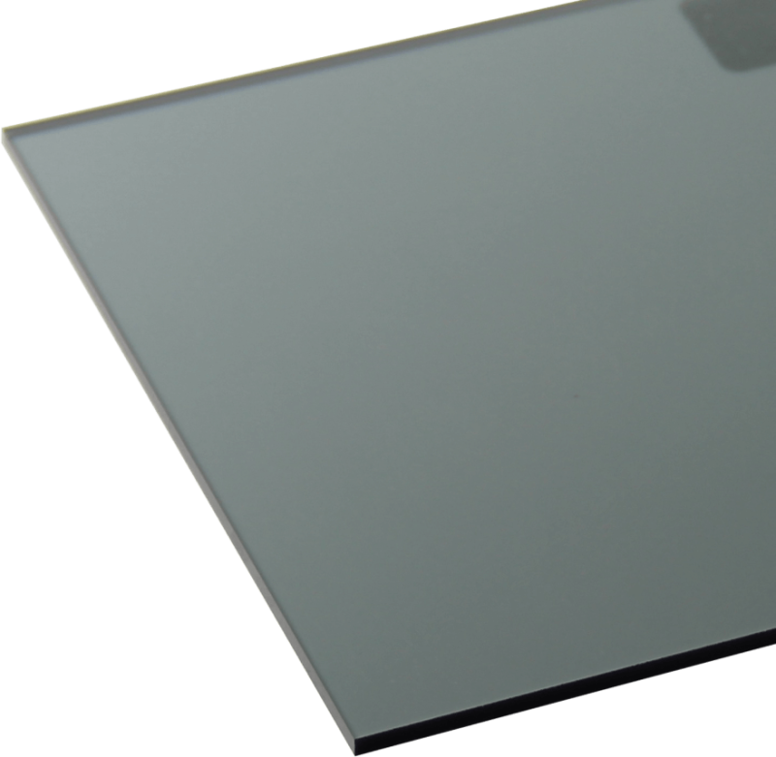
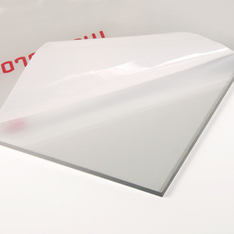
MATERIAL SELECTION AND JUSTIFICATION
FOR SLIDING DOG DOOR:
LEXAN (polycarbonate resin thermoplastic)
  Tough thermoplastic material
  High impact strength
  Lightweight
  Suitable for exterior conditions
  Cost effective
  Utilized by competitor models
    Safe to use
  Meets UL 972: Burglary Resisting Glazing Material Standard
  Available in transparent and tinted finish
LEXAN Tinted Sheet
LEXAN Sheet
Notes:
DON’T GO INTO THE WOODS
add numbers talked about on slide, density cost ect.
add sutable for exterial, sun exposer and weather ect. (enviroments consideration)
comparing weight with something known for audience
Explain thermoplastic qualities (such as deformation temps)​
add numbers talked about on slide, (density of ABS vs. Other material such as steel or aluminum)​
Add specific cost for ABS ($30 per 12" x"24".25" sheet)​
Talk about corrosion more, and talk about coefficient of thermal expansion value... explain if it would work well in both southern and northern climates​
add suitable for exterior, sun exposure and weather etc. (enviroment consideration)​
comparing weight with something known for audience ​
Discuss more about competitor models and that they also selected ABS plastic. This shows that this is reputable and valid choice for safety, calculations, environmental concerns, etc.​
Talk about temp concerns of material​
*** fix

Slide 18
MECHANICAL HARDWARE COMPONENTS
Friction Wheel
  Will 3D-print to accommodate different sizes for the wheel and other components
  Outer edge wrapped with a friction material to provide resistance between the wheel and the sliding door
Door
  LEXAN polycarbonate for easy construction and installation
Housing for electronic components
  Components will be mounted to a 3D-printed holder
  ABS plastic cover sized and built to hide electronics and components
Locking mechanism
  Servo motor
Notes:
reword second bullet on frictcion wheel (maybe what kind of friction material?)
*

Slide 19
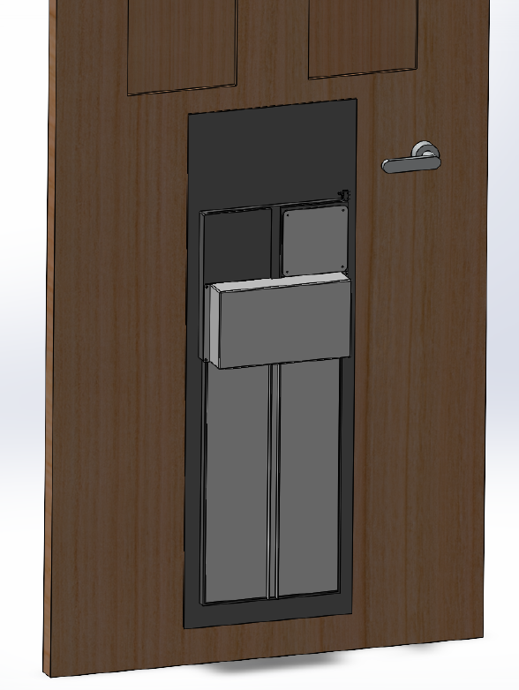
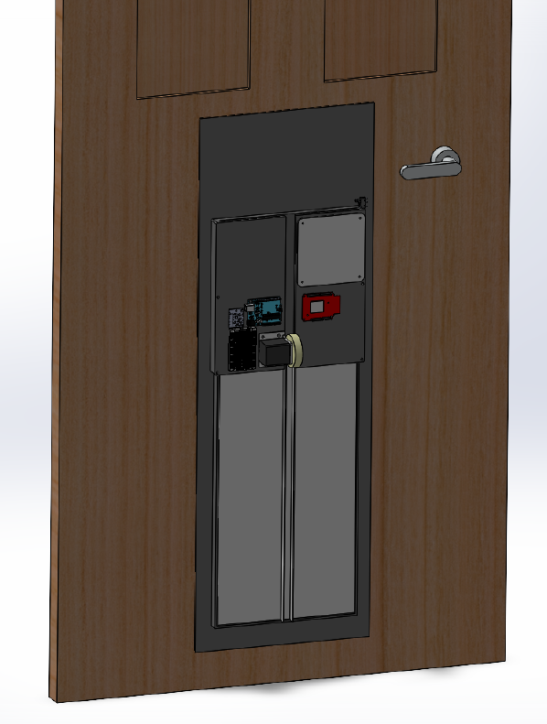
PROPOSED DESIGN
Electrical component cover shown
Electrical component cover not shown
Notes:
add version number to each model updated/made

Slide 20
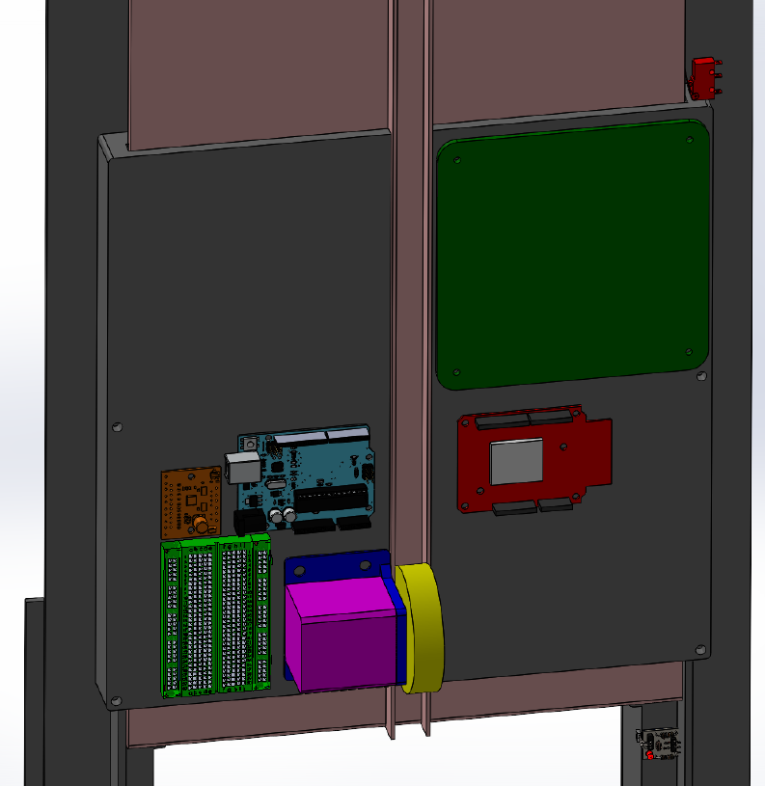
PROPOSED DESIGN
MOTOR
WHEEL
MOTOR MOUNT
UHF RFID READER
UHF RFID ANTENNA
LIMIT SWITCH
DOOR PANEL
MICROCONTROLLER
STEPPER MOTOR DRIVER
BREADBOARD
DOOR FRAME
Notes:
add version number to each model updated/made

Slide 21
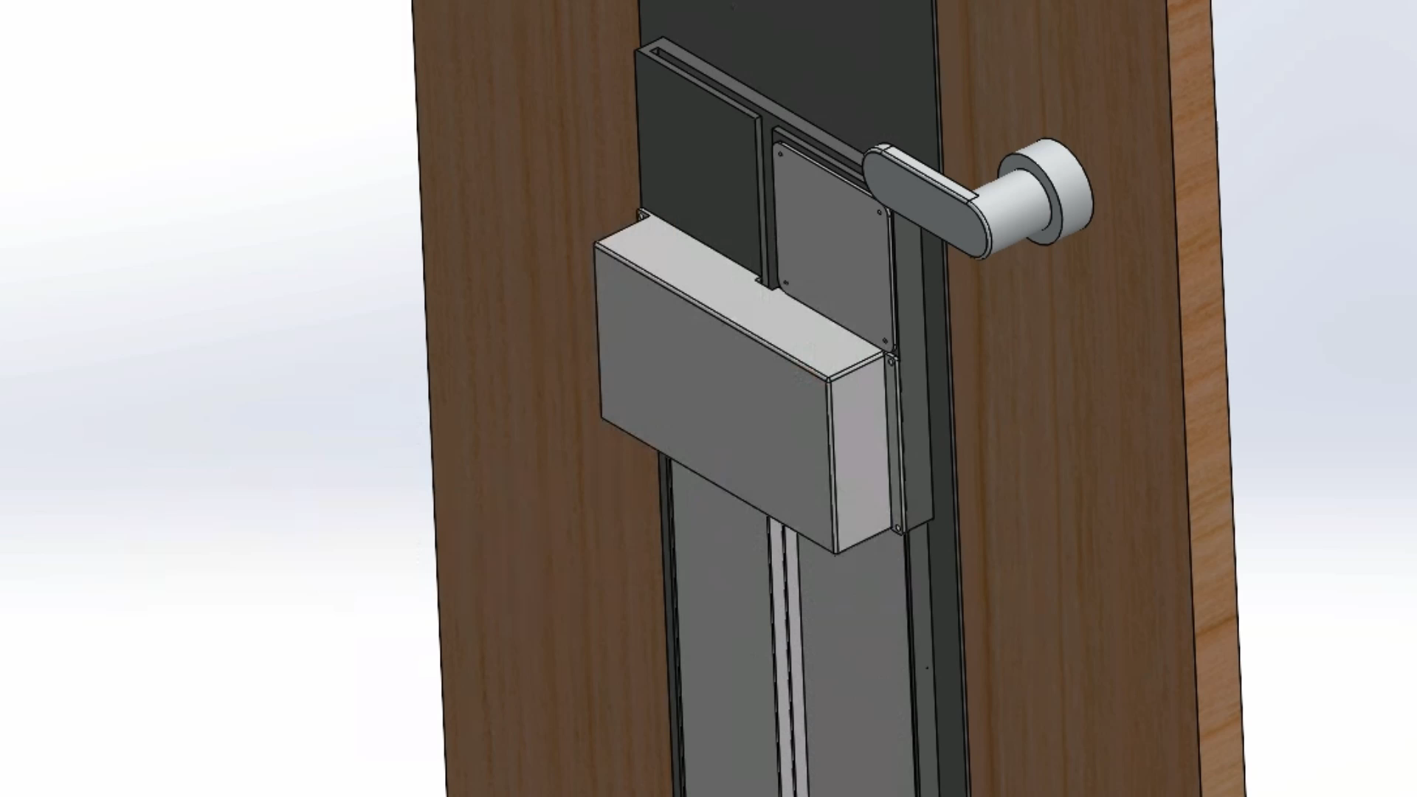
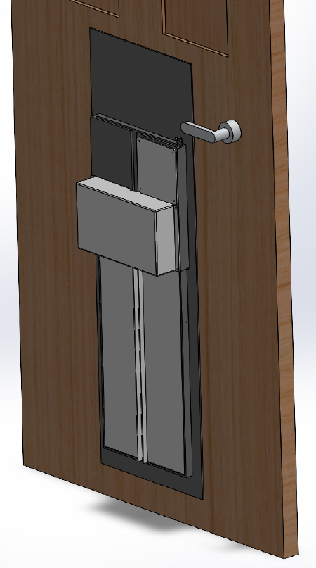
PROPOSED DESIGN
Notes:
add version number to each model updated/made

Slide 22
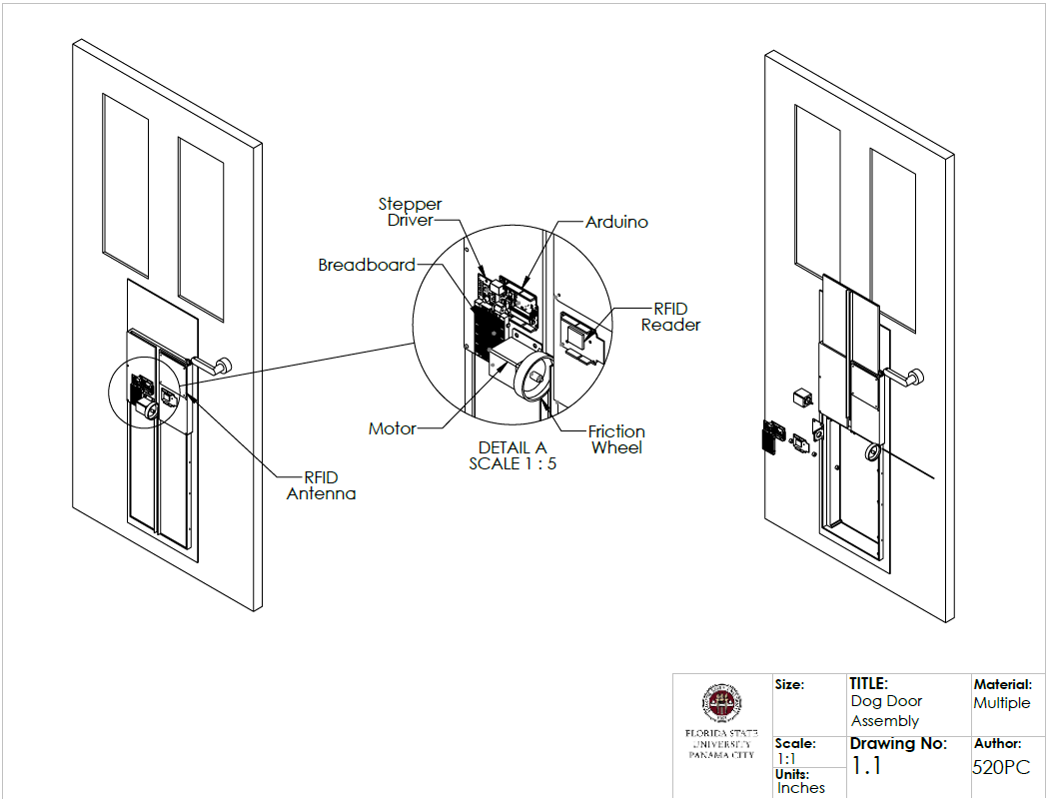
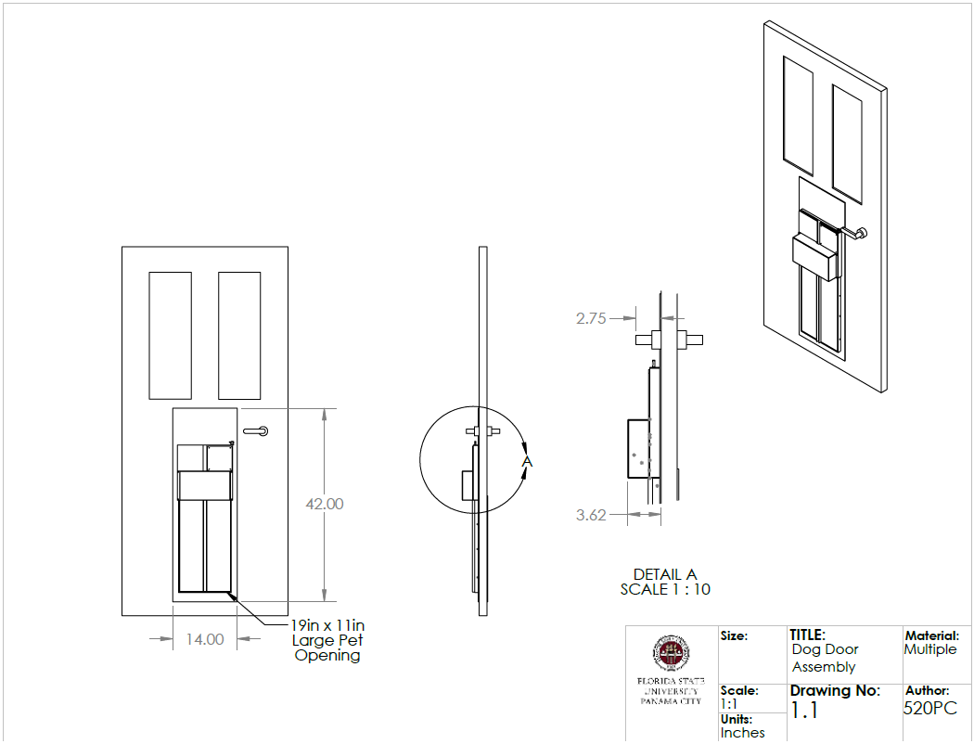
PROPOSED DIMENSIONED DESIGN
Assembly and Exploded View
Dimensioned Frame
Notes:
maybe show left drawing earlier but can keep here to talk more about it

Slide 23
COST BREAKDOWN
Category | Total Cost % | Cost
Electronics | 49% | $625
Mechanical Components | 27% | $344
Contingency Cost | 24% | $306
TOTAL COST : $1,275
Notes:
Combine emergency fund and contingency, DO NOT PUT THE WORD “EMERGENCY

Slide 24
BILL OF MATERIALS
Automatic Dog Door Parts List | Automatic Dog Door Parts List
 | Name | Part Credit | Total Cost/Part | Hardware Required
Electronics | Arduino |  | $56.95 | 4 Screws 7.85mm long
 | Jumper wires | $14.98 | $14.98 | N/A
 | Wires |  | $31.97 | N/A
 | Buttons |  | $8.98 | N/A
 | Bread Board |  | $9.98 | N/A 3M adhesive
 | Power supply |  | $21.94 | N/A
 | Resistors |  | $7.98 | N/A
 | Door Lock |  | $26.98 | TBD
 | UHF RFID tags |  | $34.95 | N/A
 | SparkFun Simultaneous UHF RFID Reader |  | $235.95 | TBD
 | UHF RFID Antenna |  | $112.16 | TBD
 | Door Position Sensor |  | $8.98 | TBD
 | Stepper Motor Driver |  | $43.09 | TBD
 | Obtruction sensor |  | $17.97 | TBD
 | Arduino LEDs |  | $9.97 | TBD
Electronic Components Cost |  | Cost: | $627.85
Notes:
Just reference
Say that we tried to minimize any custom parts and only use off the shelf components
never leave a zero, put cost there and have a credit cost
and add more for future components that need to be added.

Slide 25
BILL OF MATERIALS
Automatic Dog Door Parts List | Automatic Dog Door Parts List
 | Name | Part Credit | Total Cost/Part | Hardware Required
Mechanical Components | Friction Wheel | $8.64 | $8.64 | N/A
 | Friction Wheel surround |  | $21.94 | N/A: adhesive
 | Idle Wheels | $17.81 | $17.81 | N/A
 | Door |  | $132.79 | TBD
 | Door Frame |  | $91.49 | N/A
 | Stepper Motor |  | $15.98 | 4 m3 screws
 | Stepper Motor Mount | $11.98 | $11.98 | 4 Screws 7.85mm long
 | Hardware Cost |  | $80.00 | N/A
Mechanical Components Cost |  |  | $360.63
Contingency Cost | Adhesive |  | $22.93 | N/A
 | 3D Printer Filament |  | $34.27 | N/A
 | Solder kit |  | $27.36 | N/A
 | Battery |  | $100.00 | N/A
 | 10% of total cost |  | $120.80 | N/A
Total Contingency Cost |  |  | $647.56
Notes:
Just reference
never leave a zero, put cost there and have a credit cost
and add more for future components that need to be added.

Slide 26
PROJECT PHASE 2: EML 4552 SENIOR DESIGN 2
  Software Development
Projected Dates TBD
  Build prototype
Projected Dates TBD
  Present final work
Phase 2 Final Design Review
July 2023
Notes:
Note that this phase lasts from January 2023 to April 2023
Ending on the day of the presentation

Slide 27

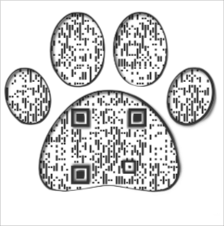

QUESTIONS?
WEBSITE
tinyurl.com/team520pc
Mandolin Brown: mhb21b@fsu.edu
Aaron Burghardt: ab21ca@fsu.edu
Jack Smith: jts21@fsu.edu
Matthew Thompson: mdt13d@fsu.edu
QUESTIONS?
Notes:
ADD PPT LINKS TO SLIDES
Q-R code or tiny url to redirect to website

Slide 28
REFERENCES

Slide 29
REFERENCES
[1] Dieter, George E. and Schmidt, Linda C. Engineering Design, 5th Edition. New York, McGraw-Hill, 2013.
[2] “Everything You Need to Know About ABS Plastic.” Creative Mechanisms.
  https://www.creativemechanisms.com/blog/everything-you-need-to-know-about-abs-plastic#:~:text=ABS%20is%20very%20structurally%20sturdy,up%20well%20to%20external%20impacts
  Accessed April 2, 2023.
[3] “Duco ABS Plastic Sheet 1/4 Inch Thick 12" x 24" - Two-Sided Rigid ABS Sheet (Textured Plastic Front & Smooth Back) –
  DIY Home Decor and Robotics Competitions Use - Black Plastic Sheet (Pack of 1).” Amazon.
  https://www.amazon.com/Duco-Plastic-Sheet-Inch-Thick/dp/B0BTWKB2NT/ref=sr_1_17?crid=2D8502YHUD6RC&keywords=sturdy%2Bplastic%2Bmaterial&qid=1677533777&s=industrial&sprefix=sturdy%2Bplastic%2Bmaterial%2Cindustrial%2C93&sr=1-17&th=1
  Accessed April 2, 2023.
[4] “PlexiDor Performance Electronic Automatic Door Mounted Cat & Dog Door.”
  https://www.petprosupplyco.com/products/plexidor-pde-door#:~:text=The%20collar%20key%20weighs%20only,ABS%20%2D%20and%20extremely%20durable%20material.
  Accessed April 2, 2023.
[5] “Acrylonitrile Butadiene Styrene (ABS) and Other Specialist Styrenics.” British Plastics Federation.
  https://www.bpf.co.uk/plastipedia/polymers/ABS_and_Other_Specialist_Styrenics.aspx
  Accessed April 2, 2023.

Slide 30
REFERENCES
[6] “Coefficient of Friction Equation and Table Chart.” Engineers Edge.
  https://www.engineersedge.com/coeffients_of_friction.htm
  Accessed April 2, 2023.
[7] “ABS Plastic Sheet - 1/2" Thick x 18" Wide x 18" Long.” Amazon.
  https://www.amazon.com/ABS-Plastic-Sheet-Thick-Wide/dp/B084H1TB7Q
  Accessed April 2, 2023.
[8] Nannestad, Chloë. “13 of the Fastest Dog Breeds in the World.” Reader’s Digest.
  https://www.rd.com/article/fastest-dog-breed/#:~:text=How%20fast%20can%20a%20dog,hour%20for%20a%20short%20distance.
  Accessed April 2, 2023.
[9] “GE Plastics LEXAN 121R Polycarbonate.”
http://k-mac-plastics.com/data-sheets/lexan-121R-data-sheet.htm
Accessed April15, 2023.
[10] “Density of Aluminium.” ThyssenKrupp.
https://www.thyssenkrupp-materials.co.uk/density-of-aluminium.html
Accessed April 16, 2023.
[11] “What is a Thermoplastic? (Definition and Examples).” TWI.
https://www.twi-global.com/technical-knowledge/faqs/what-is-a- thermoplastic#:~:text=Thermoplastics%20are%20polymers%20that%20can,and%20re%2Dused%20several%20times.
Accessed April 16, 2023.

Slide 31
REFERENCES
[12] “Model PX-2 LARGE STANDARD POWER PET® DOOR.” High Tech Pet.
https://www.hitecpet.com/autpetdoorfo.html
Accessed April 16, 2023.
[13] “ABS Black Plastic Sheet 1/16" x 24" x 48” Textured 1 Side Vacuum Forming (Pack of 4).” Amazon.
https://www.amazon.com/ABS-Plastic-Textured-Vacuum-Forming/dp/B07HGH2GTJ
Accessed April 16, 2023.
[14] “ABS Melting Point, Properties, & More.” PlasticRanger.
https://plasticranger.com/abs-melt-point/
Accessed April 16, 2023.
[15] “List of Thermal Expansion Coefficients (CTE) for Natural and Engineered Materials.” MSE Supplies.
ghghhttps://www.msesupplies.com/pages/list-of-thermal-expansion-coefficients-cte-for-natural-and-engineered-bnbnmaterials
Accessed April 16, 2023.
[16] “Top 5 FDA-approved food-grade plastics.” Fast Radius.
https://www.fastradius.com/resources/top-five-food-grade-plastics/
Accessed April 16, 2023.

Slide 32
REFERENCES
[17] “Duco ABS Plastic Sheet 1/8 Inch Thick 24" x 48" - Two-Sided Rigid ABS Sheet (Textured Plastic Front & Smooth Back)- DIY Home Decor and Robotics Competitions Use - Black Plastic Sheet (Pack of 1).”
https://www.amazon.com/Duco-Plastic-Sheet-Inch-Thick/dp/B0B78J9CR6/ref=pd_lpo_1?pd_rd_w=vxxgj&content- id=amzn1.sym.116f529c-aa4d-4763-b2b6-4d614ec7dc00&pf_rd_p=116f529c-aa4d-4763-b2b6-4d614ec7dc00&pf_rd_r=JT3QHADTWWS5E0H67TW6&pd_rd_wg=djdZZ&pd_rd_r=2581a3d9-5b48-42bd-9031-3c116d4f0f45&pd_rd_i=B0B78J9CR6&th=1
Accessed April 16, 2023.
[18] “Clear Lexan Sheet, Polycarbonate Sheet.” Polymer Plastics Company,LC.
https://www.polymerplastics.com/transparents_lexan.shtml#:~:text=Polycarbonate%20Lexan%209034%20is%20UlV,density%20rating%20less%20than%2075
Accessed April 16, 2023.
[19] “Typical Shrinkage Values for Miscellaneous Plastic Resins.” Plastic Service Centers.
https://www.plasticservice.com/shrinkageinformation.aspx
Accessed 16, 2023.

Slide 33
REFERENCES
[20] “What Pet Door Size Should You Buy Based On Your Dog's Breed.” Endura Flap
https://enduraflap.com/blogs/pet-doors/choosing-the-right-size-pet-door
Accessed April 18, 2023.
[21] “1/4" X 48" X 96" CLEAR POLYCARBONATE SHEET.” ePlastics.
https://www.eplastics.com/LEXAN-CLR-0-250AM48X96
[22] “TRANSPARENT DARK SMOKED GREY LEXAN SHEET 1/4" THICK.” VIP Plastics.
https://www.amazon.com/Duco-Plastic-Sheet-Inch-Thick/dp/B0B78J9CR6/ref=pd_lpo_1?pd_rd_w=vxxgj&content- id=amzn1.sym.116f529c-aa4d-4763-b2b6-4d614ec7dc00&pf_rd_p=116f529c-aa4d-4763-b2b6-4d614ec7dc00&pf_rd_r=JT3QHADTWWS5E0H67TW6&pd_rd_wg=djdZZ&pd_rd_r=2581a3d9-5b48-42bd-9031-3c116d4f0f45&pd_rd_i=B0B78J9CR6&th=1
Accessed April 18, 2023.
[23] “Polycarbonate Lexan Sheet Clear 0.250” - 1/4" (6 mm) 24" x 48" – Thermoforming.” Amazon.
https://www.amazon.com/Polycarbonate-Lexan-Sheet-Clear-0-250/dp/B07KCYC7K7/ref=sr_1_3?crid=2HQY4AB37GENQ&keywords=lexan+1%2F4+inch+sheet&qid=1681667455&sprefix=lexan+1%2F4+inch+shee%2Caps%2C103&sr=8-3&ufe=app_do%3Aamzn1.fos.006c50ae-5d4c-4777-9bc0-4513d670b6bc
Accessed April 18, 2023

Slide 34
EXTRA MATERIALS NOTES SLIDE
**ABS plastic looks relatively flexible at ¼ in. Should we increase the thickness to ½ in?
LEXAN (polycarbonate resin thermoplastic) is a material used by the high tech powerpet door. It has a yield and tensile strength of 65 MPa and 65 MPa. We might consider keeping the frame made out of ABS plastic, and the sliding door itself out of LEXAN.
LEXAN is almost as light as ABS; density is: 0.0434 lb/in^3 vs abs which is 0.038 lb/in³
https://www.matweb.com/search/datasheet.aspx?matguid=cda0ab793fed4ed6a7e5df4902937a4b&ckck=1
https://dielectricmfg.com/resources/knowledge-base/lexan/#:~:text=Lexan%C2%AE%20(Polycarbonate)&text=Lexan%C2%AE%20offers%20an%20excellent,available%20in%20clear%20and%20color.
Consider plexiglass as door material?
If considering a clear material such as lexan or plexiglass, we need to tint it so it wont be transparent (safety hazard for running dog)
I’d say keep the actual door frame as ABS because that’s what every other door seems to use
https://www.youtube.com/watch?v=i_ncaGwQZuw
This is a good video comparing polycarbonate (lexan) and acrylic (plexiglass)
https://www.youtube.com/watch?v=FSP-2VINGa4
https://www.amazon.com/Polycarbonate-Lexan-Sheet-Clear-0-250/dp/B07KCYC7K7/ref=sr_1_4?crid=AKGMA9UFXSJ5&keywords=lexan+sheet&qid=1681676098&sprefix=lexan+sheet%2Caps%2C115&sr=8-4&ufe=app_do%3Aamzn1.fos.006c50ae-5d4c-4777-9bc0-4513d670b6bc

Slide 35
PROJECT
INSPIRATION

Slide 36
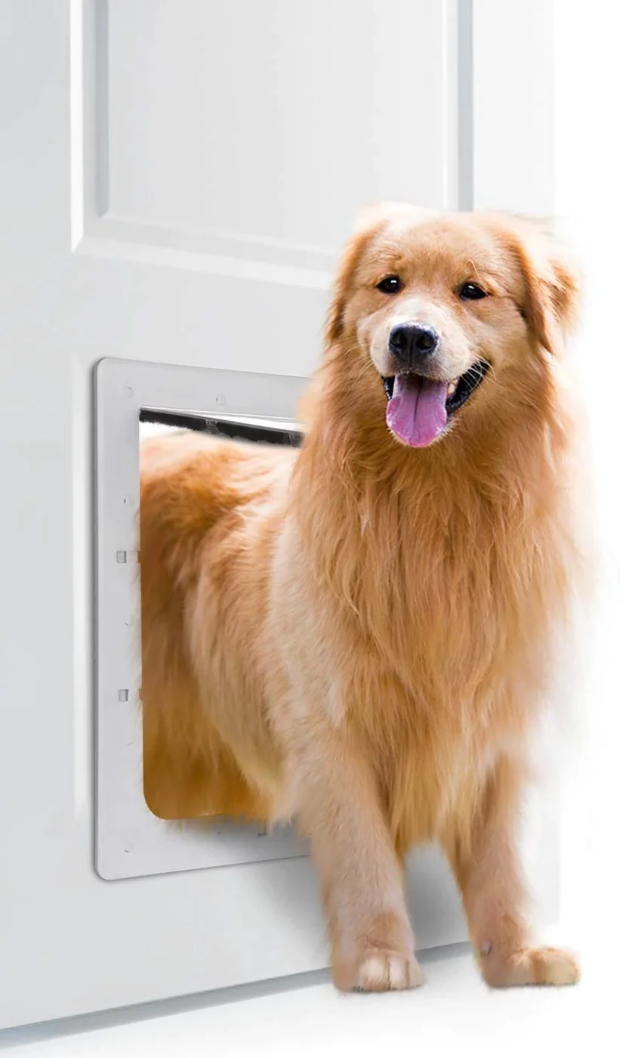
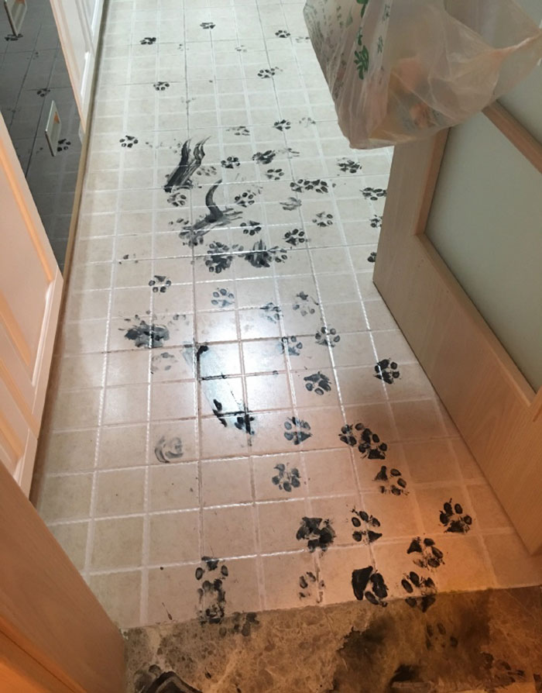

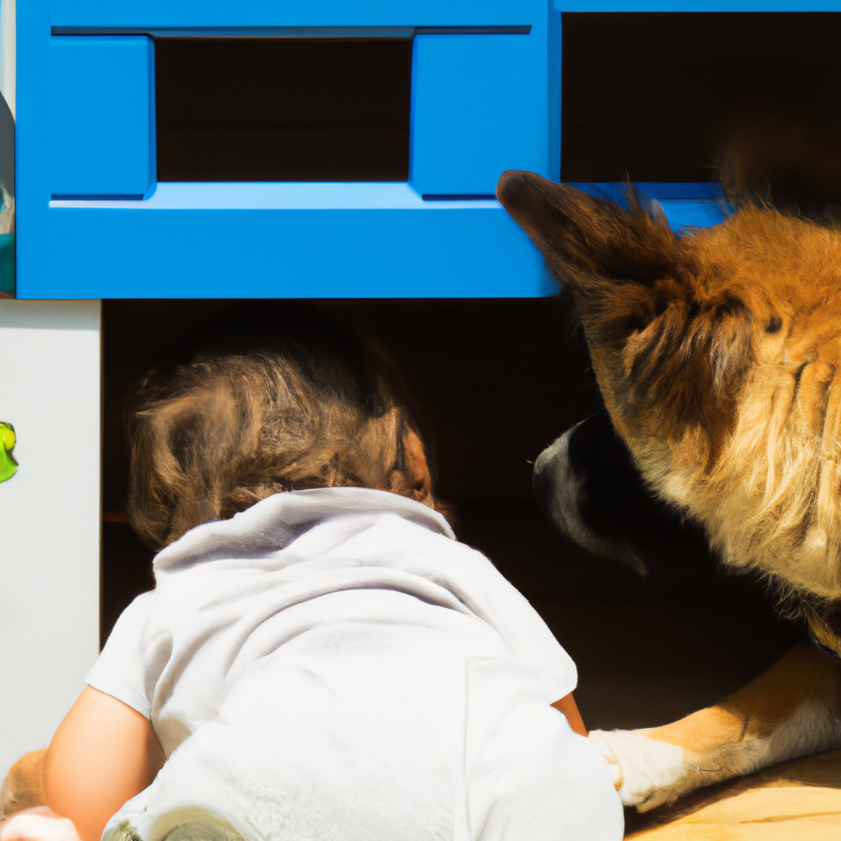
PROJECT INSPIRATION
Desire to limit and control pet access through home interior and exterior
Traditional dog doors provide:
NO CONSTRAINED ACCESS
INSUFFICIENT SECURITY
Source: boredpanda.com
Source: myanimals.com
Source: app.simplified.com
Source: ownpets.com
Notes:
Change date to july 23
add software development

Slide 37
SUPPLEMENTARY
VIEWS

Slide 38
INTERMEDIATE DESIGN REVIEW IMAGES
Supplementary views:

Slide 39
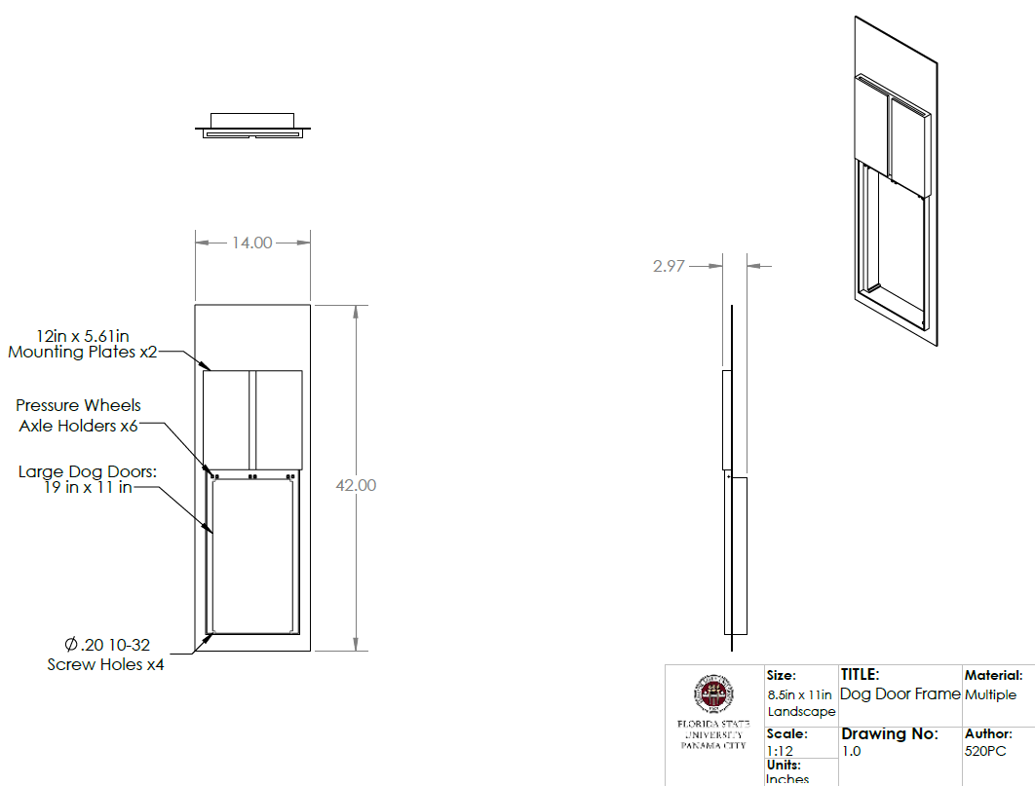
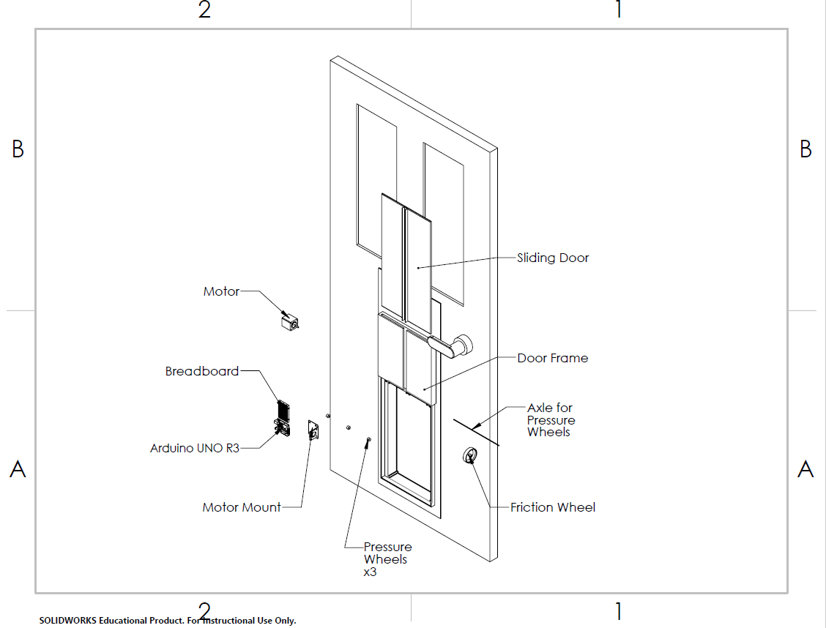
SUPPLEMENTARY VIEWS
Notes:
add version number to each model updated/made

Slide 40
TARGETS
AND
METRICS

Slide 41
TARGETS AND METRICS
Cost: Price of Materials and Production (< $2,000)
  Project budget allotted by FSU and sponsors
Size: Area of Opening (19” x 11”)
  Standard dog door size for large breeds^{[20]}
Response to Data Input: Door Unlock Speed (1 second)
  Target defined by team
Response to Data Input: Door Open Speed (2 seconds)
  Target defined by team
Limited Accessibility: Accept/Decline Signal (Y/N)
  Target based on project objective
Safety: Sense Door Obstruction (Y/N)
  Target based on project objective
Remote Capability: Website/App Operable (Y/N)
  Target based on project goal
Notes:
ADD PICTURE EARLY ON

Slide 42
EXTRA
MATERIALS
INFORMATION

Slide 43
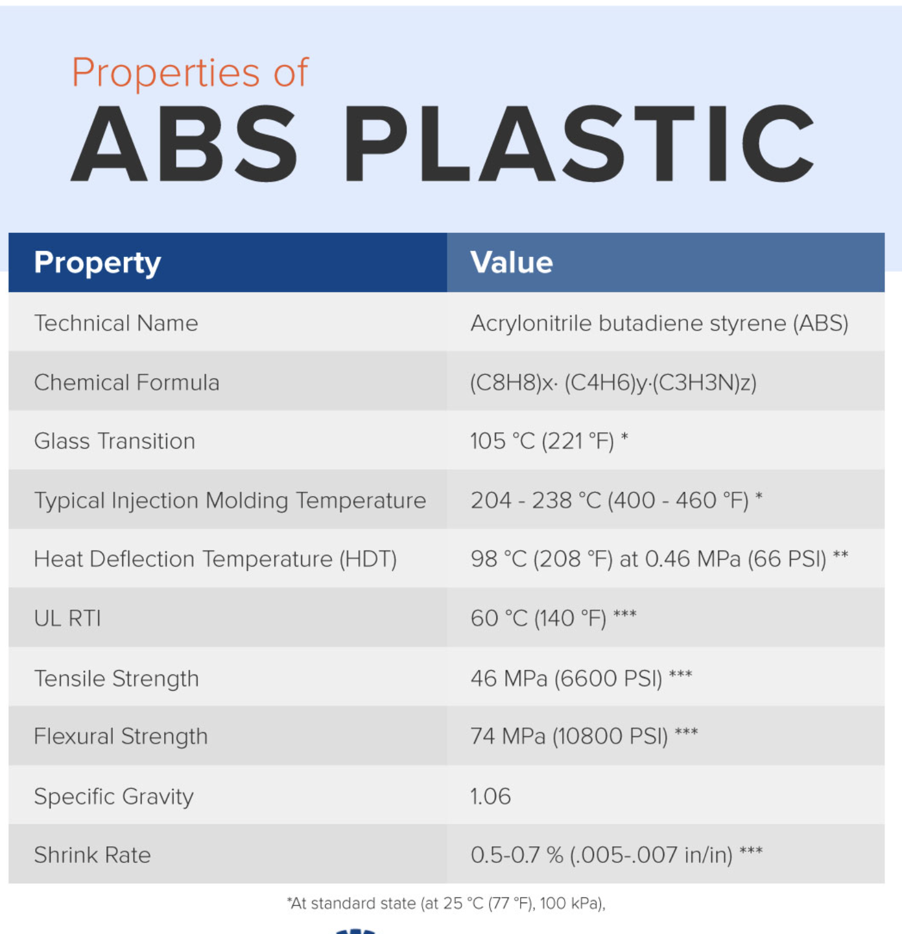
SUPPLEMENTARY MATERIAL
ABS Plastic Properties, Ref. [2]

Slide 44
MATERIAL SELECTION AND JUSTIFICATION
  Lightweight
  ABS Plastic Density^{[7]}:
  0.038 lb/in³
  Aluminum Density^{[10]}:
    0.098 lb/in³
  Lexan (polycarbonate resin thermoplastic) density^{[9]}:
    0.0434 lb/in³
    **Used by high tech powerpet door
ABS Plastic Properties, Ref. [2]
Notes:
add numbers talked about on slide, density cost ect.
add sutable for exterial, sun exposer and weather ect. (enviroments consideration)
comparing weight with something known for audience
Explain thermoplastic qualities (such as deformation temps)​
add numbers talked about on slide, (density of ABS vs. Other material such as steel or aluminum)​
Add specific cost for ABS ($30 per 12" x"24".25" sheet)​
Talk about corrosion more, and talk about coefficient of thermal expansion value... explain if it would work well in both southern and northern climates​
add suitable for exterior, sun exposure and weather etc. (enviroment consideration)​
comparing weight with something known for audience ​
Discuss more about competitor models and that they also selected ABS plastic. This shows that this is reputable and valid choice for safety, calculations, environmental concerns, etc.​
Talk about temp concerns of material​

Slide 45
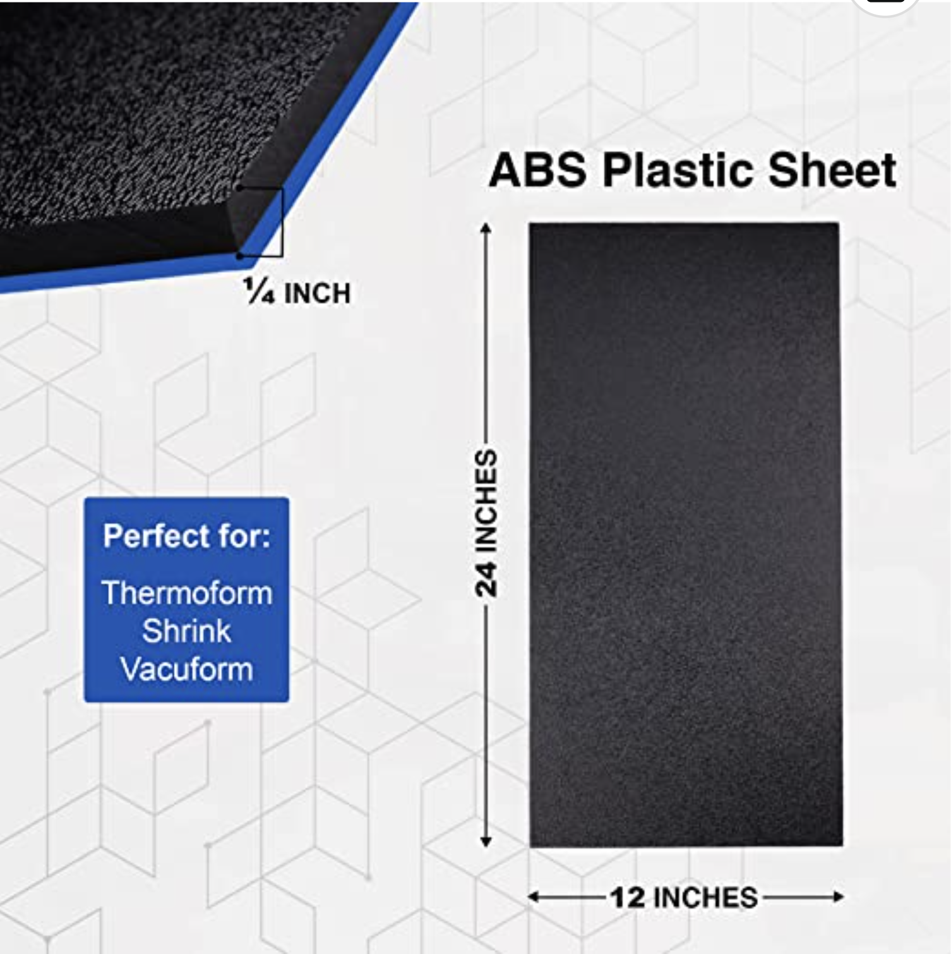
MATERIAL SELECTION AND JUSTIFICATION
  Easily Accessible
  Abundant supply by online sellers
  Used in a variety of everyday applications
    Home appliances
    Automotive applications
    Toys
    Food-grade products
  Cost Effective
    <$30 per sheet
    (1/4” x 12” x 24”)
Selected material
Ref. [3]
ABS Plastic Properties, Ref. [2]
Notes:
add numbers talked about on slide, density cost ect.
add sutable for exterial, sun exposer and weather ect. (enviroments consideration)
comparing weight with something known for audience
Explain thermoplastic qualities (such as deformation temps)​
add numbers talked about on slide, (density of ABS vs. Other material such as steel or aluminum)​
Add specific cost for ABS ($30 per 12" x"24".25" sheet)​
Talk about corrosion more, and talk about coefficient of thermal expansion value... explain if it would work well in both southern and northern climates​
add suitable for exterior, sun exposure and weather etc. (enviroment consideration)​
comparing weight with something known for audience ​
Discuss more about competitor models and that they also selected ABS plastic. This shows that this is reputable and valid choice for safety, calculations, environmental concerns, etc.​
Talk about temp concerns of material​

Slide 46
MATERIAL SELECTION AND JUSTIFICATION
  LEXAN DOOR PANEL
  High strength and impact resistance
    Tensile Strength^{[2]}: 62.1 MPa (9000 psi)
    Flexural Strength^{[2]}: 96.5 MPa (14000 psi)
  Lightweight
    Lexan (polycarbonate resin thermoplastic) density^{[9]}:
    0.0434 lb/in³
  Suitable for exterior conditions
    Deflection Temperature^{[18]}: 270º F
    Shrinkage Rate^{[19]}: 0.5% - 0.7%
  Meets UL 972: Burglary Resisting Glazing Material Standard
Notes:
add numbers talked about on slide, density cost ect.
add sutable for exterial, sun exposer and weather ect. (enviroments consideration)
comparing weight with something known for audience
Explain thermoplastic qualities (such as deformation temps)​
add numbers talked about on slide, (density of ABS vs. Other material such as steel or aluminum)​
Add specific cost for ABS ($30 per 12" x"24".25" sheet)​
Talk about corrosion more, and talk about coefficient of thermal expansion value... explain if it would work well in both southern and northern climates​
add suitable for exterior, sun exposure and weather etc. (enviroment consideration)​
comparing weight with something known for audience ​
Discuss more about competitor models and that they also selected ABS plastic. This shows that this is reputable and valid choice for safety, calculations, environmental concerns, etc.​
Talk about temp concerns of material​

Slide 47
MATERIAL SELECTION AND JUSTIFICATION
  Thermoplastic – Polymers that can be softened through heating before being processed and then left to cool and harden. They show no changes in chemical properties after heating, meaning they can be re-melted and re-used several times.^{[11]}
  High strength and impact resistance
    Tensile Strength^{[2]}: 46 MPa (6600 psi)
    Flexural Strength^{[2]}: 74 MPa (10800 psi)
  Lightweight
    ABS plastic density^{[7]}: 0.038 lb/in³ (our frame selection)^{[12]}
    Aluminum density^{[10]}: 0.098 lb/in³ (other competitor models)^{[4]}
Notes:
add numbers talked about on slide, density cost ect.
add sutable for exterial, sun exposer and weather ect. (enviroments consideration)
comparing weight with something known for audience
Explain thermoplastic qualities (such as deformation temps)​
add numbers talked about on slide, (density of ABS vs. Other material such as steel or aluminum)​
Add specific cost for ABS ($30 per 12" x"24".25" sheet)​
Talk about corrosion more, and talk about coefficient of thermal expansion value... explain if it would work well in both southern and northern climates​
add suitable for exterior, sun exposure and weather etc. (enviroment consideration)​
comparing weight with something known for audience ​
Discuss more about competitor models and that they also selected ABS plastic. This shows that this is reputable and valid choice for safety, calculations, environmental concerns, etc.​
Talk about temp concerns of material​

Slide 48
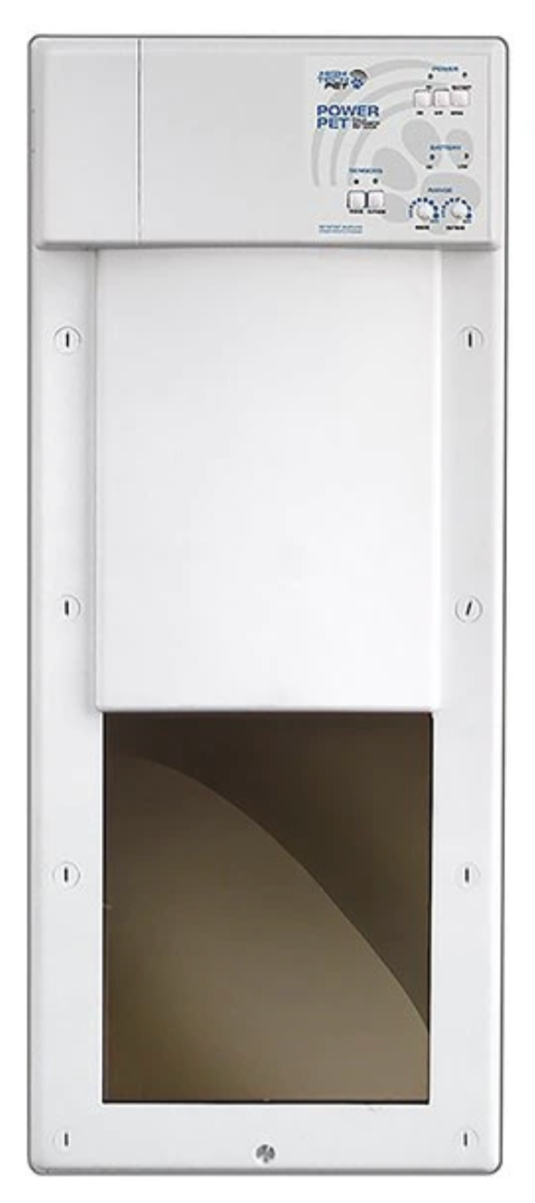
MATERIAL SELECTION AND JUSTIFICATION
  Suitable for exterior conditions
    Deflection Temperature^{[2]}: 208º F
    Shrinkage Rate^{[2]}: 0.5% - 0.7%
    UV-stabilized options available
    UV-protectant coating/paint options available
    Endorsed by competitor models
  Safe to Use
    Non-toxic
    Food-grade plastic
Competitor model (ABS plastic frame)^{[12]}
Notes:
add numbers talked about on slide, density cost ect.
add sutable for exterial, sun exposer and weather ect. (enviroments consideration)
comparing weight with something known for audience
Explain thermoplastic qualities (such as deformation temps)​
add numbers talked about on slide, (density of ABS vs. Other material such as steel or aluminum)​
Add specific cost for ABS ($30 per 12" x"24".25" sheet)​
Talk about corrosion more, and talk about coefficient of thermal expansion value... explain if it would work well in both southern and northern climates​
add suitable for exterior, sun exposure and weather etc. (enviroment consideration)​
comparing weight with something known for audience ​
Discuss more about competitor models and that they also selected ABS plastic. This shows that this is reputable and valid choice for safety, calculations, environmental concerns, etc.​
Talk about temp concerns of material​

Slide 49
MATERIAL SELECTION AND JUSTIFICATION
  Cost-Effective
    $5.60/ft² (per 1/8 inch sheet)
  Easily Accessible
    Abundant supply by online sellers
    Used in a variety of everyday applications
    Home appliances
    Automotive applications
    Toys
    Food-grade products
Notes:
add numbers talked about on slide, density cost ect.
add sutable for exterial, sun exposer and weather ect. (enviroments consideration)
comparing weight with something known for audience
Explain thermoplastic qualities (such as deformation temps)​
add numbers talked about on slide, (density of ABS vs. Other material such as steel or aluminum)​
Add specific cost for ABS ($30 per 12" x"24".25" sheet)​
Talk about corrosion more, and talk about coefficient of thermal expansion value... explain if it would work well in both southern and northern climates​
add suitable for exterior, sun exposure and weather etc. (enviroment consideration)​
comparing weight with something known for audience ​
Discuss more about competitor models and that they also selected ABS plastic. This shows that this is reputable and valid choice for safety, calculations, environmental concerns, etc.​
Talk about temp concerns of material​

Slide 50
REQUIREMENTS
AND
CALCULATIONS

Slide 51
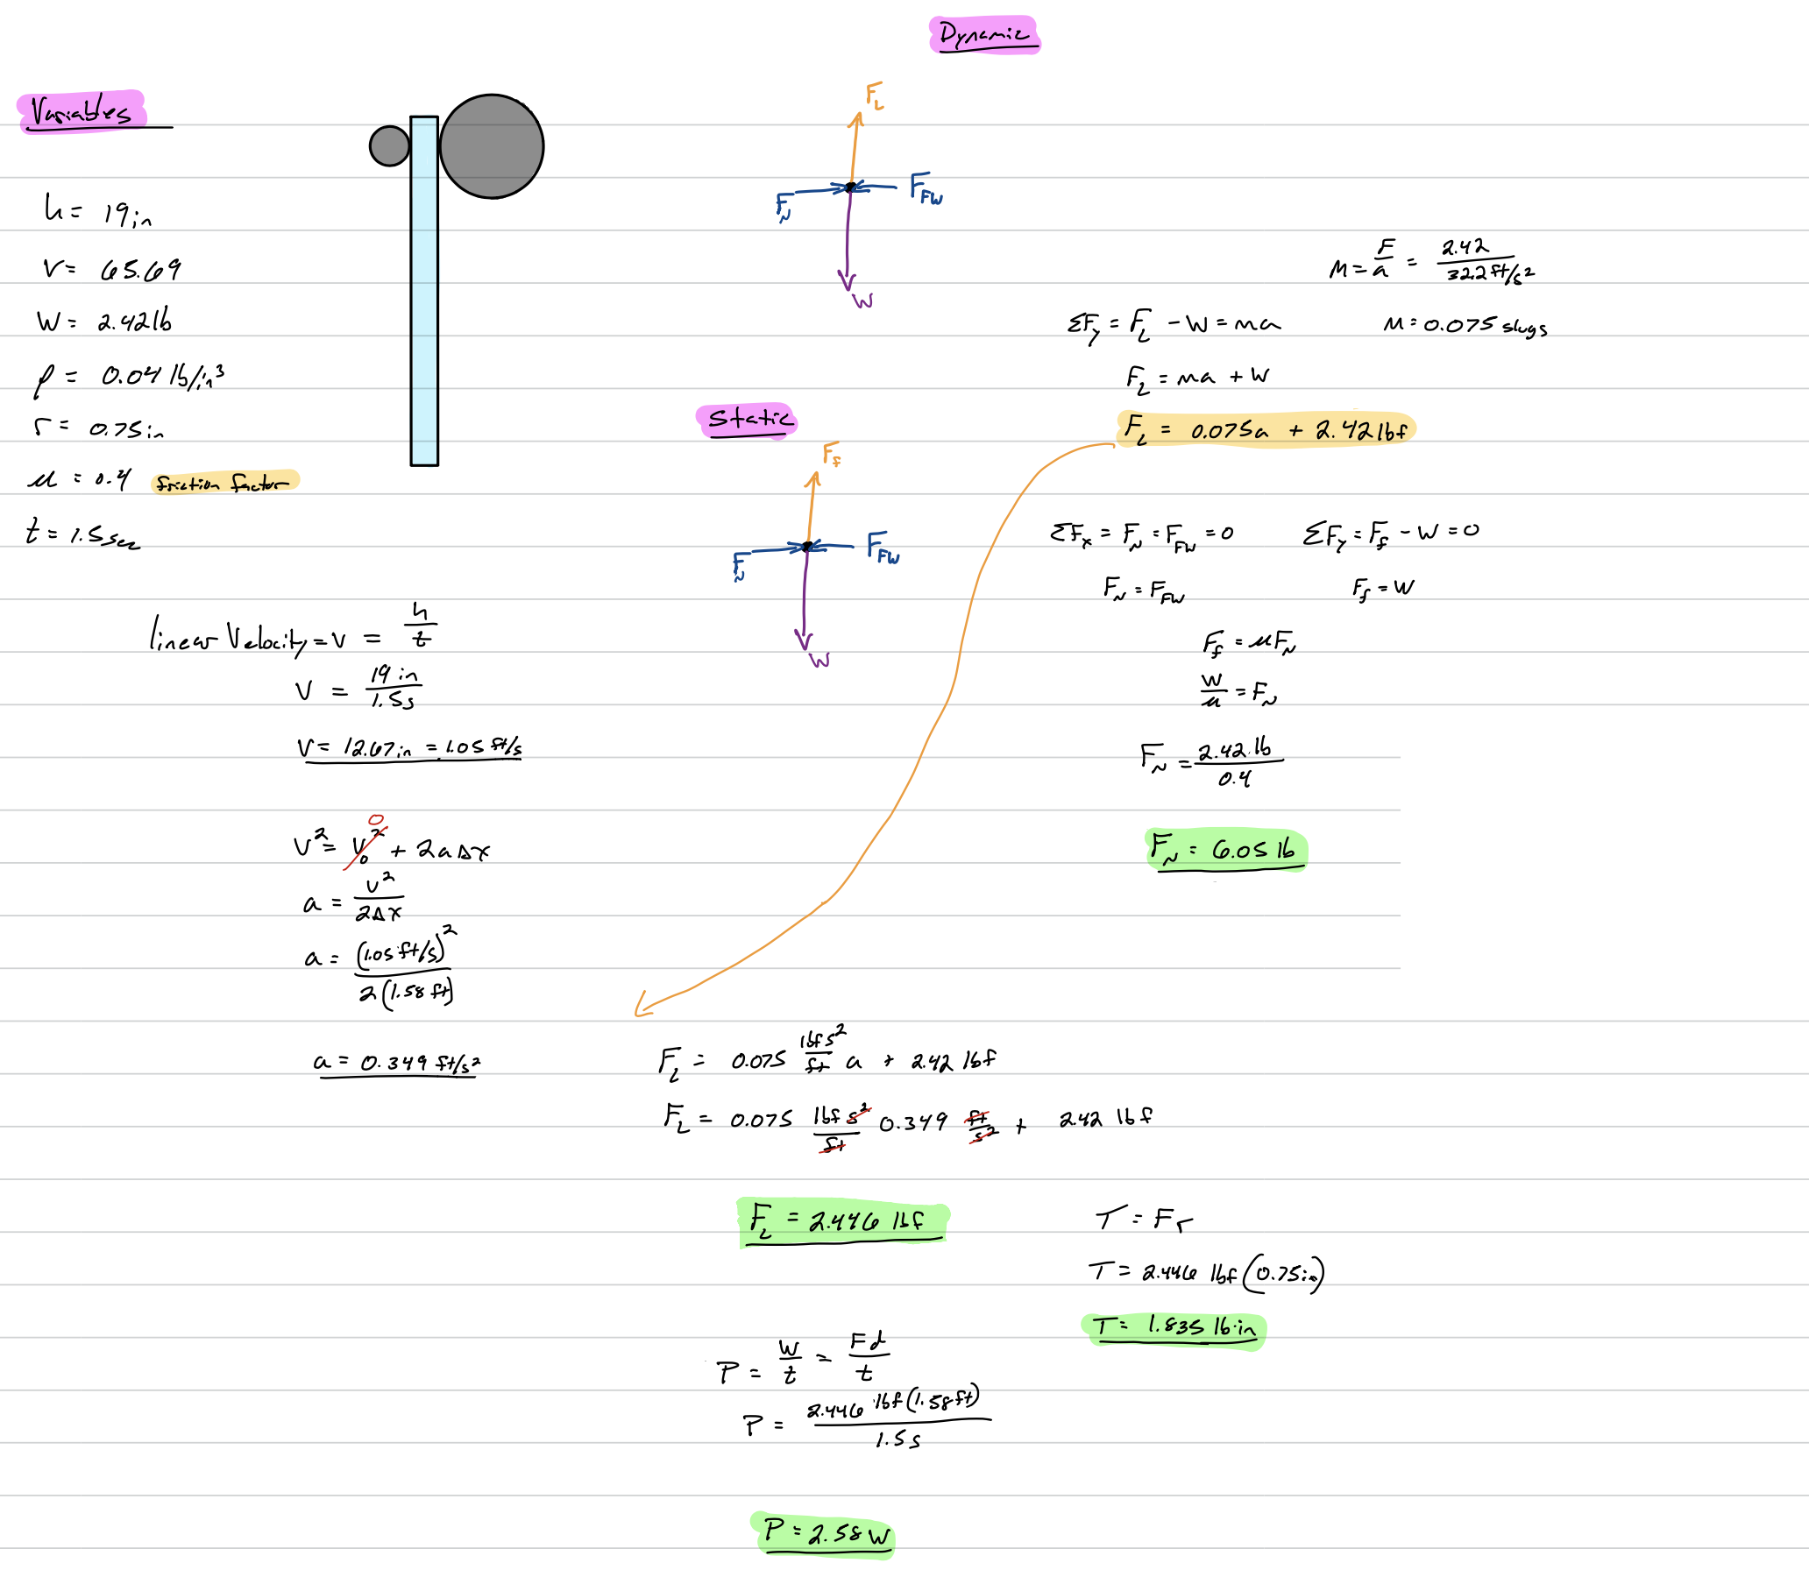
SUPPLEMENTARY MATERIAL
Preliminary force/power calculations

Slide 52
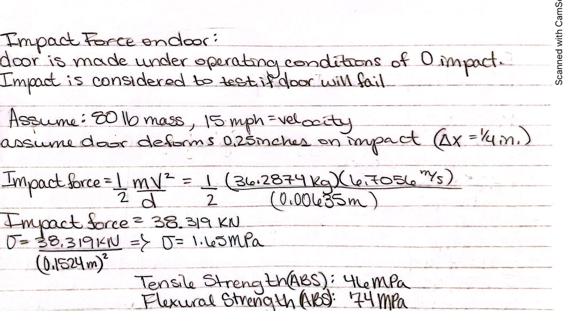
SUPPLEMENTARY MATERIAL
Preliminary impact force calculation

Slide 53
MOTOR CALCULATIONS
Requirements:
  Force to lift door of specified weight (as defined by volume and density)
  Torque applied by force and size of friction wheel
  Power to meet these requirements
Motor Requirements
  Motor torque minimum: 1.8 lb_{f} • in.
  Power minimum: 2.6 Watts
  Force Requirements
    Compressive force minimum (no slip condition) : 6 lb_{f}
Notes:
This is calculated with a coefficient of friction of 0.4 and an opening time of 1.5 seconds
check hp converstion
power at steady state, and need power at start up[

Slide 54
PART
CONSIDERATIONS

Slide 55
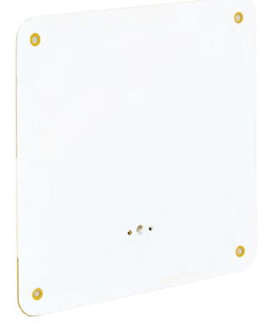
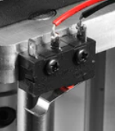
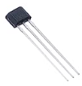
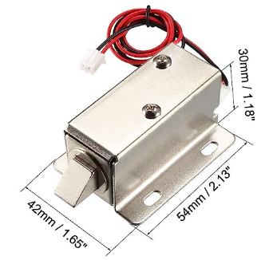
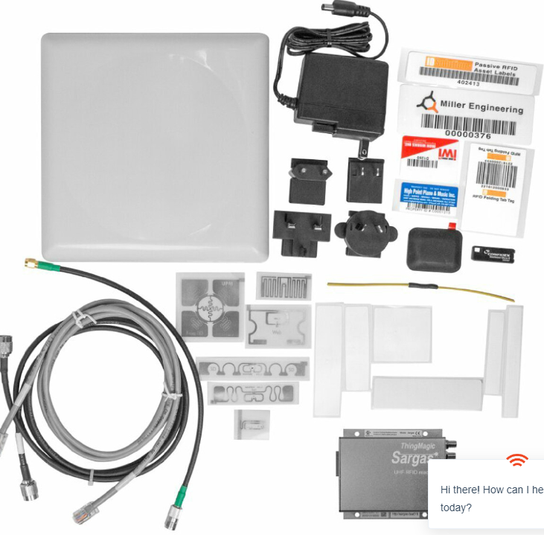
BILL OF MATERIALS CONT.
Parts Considered (Not Currently Using)
Name | Description | Using this part? | Total Cost/Part | Reference Sheet | Reason removed
Door Position Sensor (DPS) | Hall Effect Sensor (magnetic) | N | $13.98 | Ref4 | Cost
Door Position Sensor | Micro Limit Switches | N | $24.98 | Ref1 | Cost
RFID Antenna | Reads incoming signal from RFID | N | $130.98 | Ref15 | Compatibilty
Door Lock | Electromagnetic Solenoid Lock | N | $17.48 | Ref8 | Compatibilty
Sargas 2port UHF reader | UHF RFID Reader kit | N | $693.00 | Ref20 | Cost
 |  | Total Cost | $880.42
These parts were discontinued for our design because their higher cost, not bringing any additional value, or compatibility issues. The reason for exclusion of part is listed in "Reason removed" column on the graph

Slide 56
Door Position Sensor
Parts considered:
  Hall effect sensor
  Micro limit switch
Part selected:
  Hinge lever switch
Reasoning
  Thoughtful design and implementation into our product.
  Cost/quantity
  Reliability/signal noise reduction

Slide 57
Door Lock
Parts considered:
  Electromagnetic solenoid lock
Part selected:
  Servomotor
Reasoning
  Fitment issues for a slim design

Slide 58
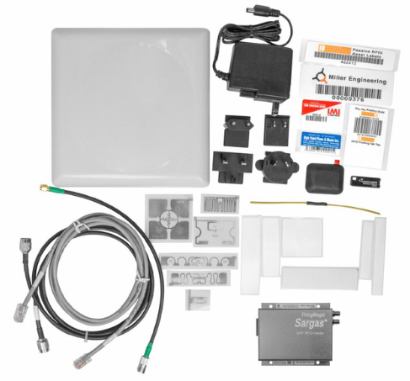
RFID Antenna
Parts considered:
  Sargas 2-Port UHF Reader Kit
Part selected:
  SparkFun Simultaneous RFID Reader
  SparkFun RFID Antenna
Reasoning
  Cost of $300 vs $693
  No software cost per part
  Arduino compatibility
  150 tag reads/second
  Up to 16’ detection range

Slide 59
BOM AND BUDGET

Slide 60
INITIAL BILL OF MATERIALS
 |  | Automatic Dog Door Parts List
 |  | Name | Part Credit | Total Cost/Part | Hardware Required
Electronics |  | Arduino |  | $56.95 | 4 Screws 7.85mm long
 |  | Jumper wires | $14.98 | $14.98 | N/A
 |  | Wires |  | $31.97 | N/A
 |  | Buttons |  | $8.98 | N/A
 |  | Bread Board |  | $9.98 | N/A 3M adhesive
 |  | Power supply |  | $21.94 | N/A
 |  | Resistors |  | $7.98 | N/A
 |  | Door Lock |  | $26.98 | TBD
 |  | RFID tags |  | $34.95 | N/A
 |  | SparkFun Simultaneous RFID Reader |  | $235.95 | TBD
 |  | RFID Antenna |  | $112.16 | TBD
 |  | Door Position Sensor |  | $8.98 | TBD
 |  | Stepper Motor Driver |  | $43.09 | TBD
 |  | Obtruction sensor |  | $17.97 | TBD
 |  | Arduino LEDs |  | $9.97 | TBD
 |  |  | Cost: | $627.85
Notes:
Just reference
Say that we tried to minimize any custom parts and only use off the shelf components
never leave a zero, put cost there and have a credit cost
and add more for future components that need to be added.

Slide 61
INTIAL BILL OF MATERIALS
 | Automatic Dog Door Parts List
 | Name |  | Part Credit | Total Cost/Part | Hardware Required
Mechanical Components | Friction Wheel |  | $8.64 | $8.64 | N/A
 | Friction Wheel surround |  |  | $21.94 | N/A: adhesive
 | Idle Wheels |  | $17.81 | $17.81 | N/A
 | Door |  |  | $132.79 | TBD
 | Door Frame |  |  | $91.49 | N/A
 | Stepper Motor |  |  | $15.98 | 4 m3 screws
 | Stepper Motor Mount |  | $11.98 | $11.98 | 4 Screws 7.85mm long
 | Hardware Cost |  |  | $80.00 | N/A
Mechanical Components Cost |  |  | $360.63
Contingency Cost | Adhesive |  |  | $22.93 | N/A
 | 3D Printer Filament |  |  | $34.27 | N/A
 | Solder kit |  |  | $27.36 | N/A
 | Battery |  |  | $100.00 | N/A
 | Emergency Funds |  |  | $120.80 | N/A
 |  |  | Cost | $647.56
 |  |  | Total Cost | $1275.41
Notes:
Just reference
never leave a zero, put cost there and have a credit cost
and add more for future components that need to be added.

Slide 62
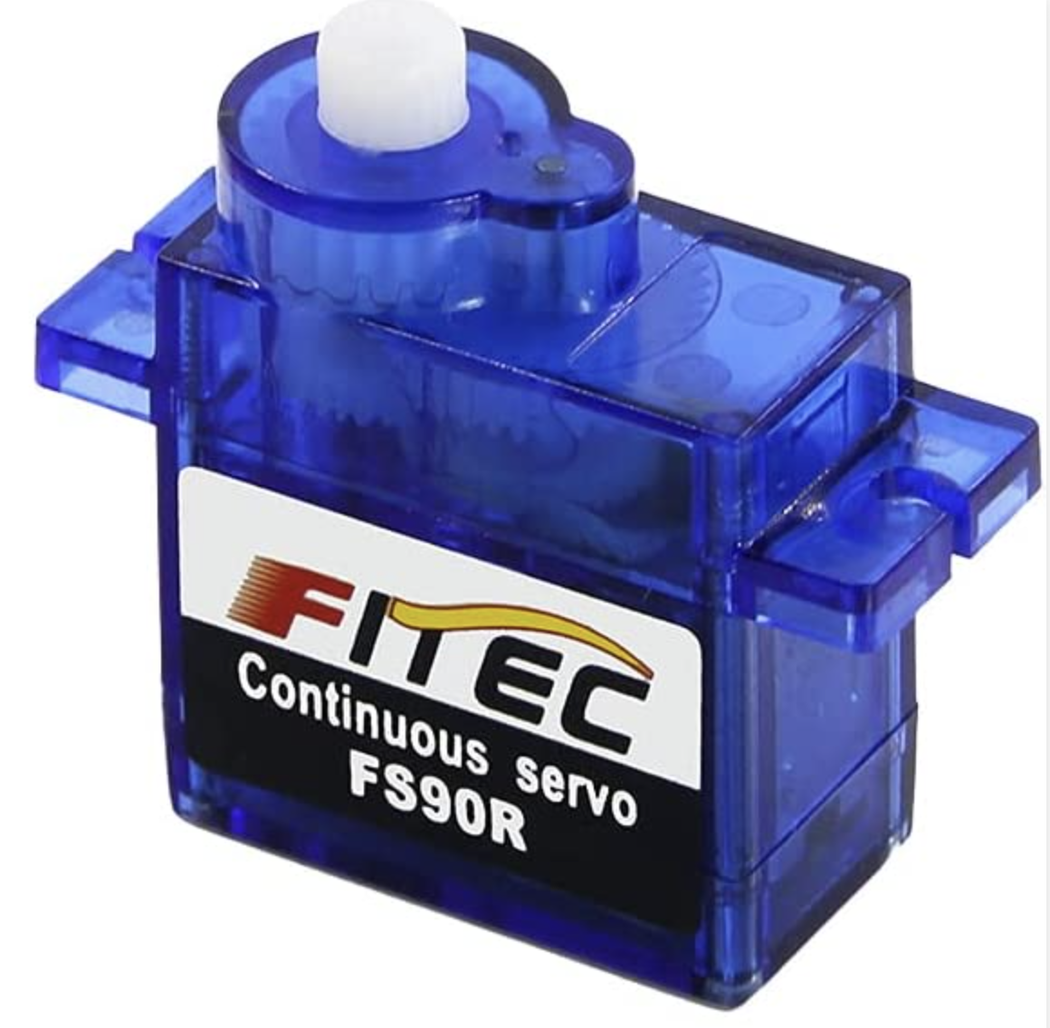
BILL OF MATERIALS
 | Automatic Dog Door Parts List
 | Name | Description | Part Credit | Total Cost/Part | Reference Sheet | Hardware Required
Electronics | Arduino | Uno Wifi Rev2 |  | $57 | Ref5 | 4 Screws 7.85mm long self tap
 | Arduino/Breadboard wires | Sourced From School Inventory | $15 | $15 | Ref16 | N/A
 | Wires | Used to connect components |  | $32 | Ref27 | N/A
 | Buttons | Used to control the door manually |  | $9 | Ref30 | N/A
 | Bread Board | Solderless Board Kit |  | $10 | Ref7 | N/A 3M adhesive included
 | Powersupply | Used to power machine |  | $22 | Ref17 | N/A
 | Resistors | Provide correct voltage to all components |  | $8 | Ref14 | N/A
 | Door Lock | Servomotor |  | $27 | Ref19 | TBD
 | RFID tags | Will be placed on dog collar |  | $35 | Ref25 | N/A
 | SparkFun Simultaneous RFID Reader | UHF RFID Reader |  | $236 | Ref10 | TBD
 | RFID Antenna | Reads incoming signal from RFID |  | $112 | Ref18 | TBD
 | Door Position Sensor | Hinge Lever Switch |  | $9 | Ref2 | TBD
 | Stepper Motor Driver | Used to make continuous step motor movement |  | $43 | Ref11 | TBD
 | Obtruction sensor | Laser sensors to detect object in doorway |  | $18 | Ref12 | TBD
 | Arduino LEDs | Used to display parameters for user |  | $10 | Ref9 | TBD
Mechanical Components | Friction Wheel | 3D printed/not purchased | $9 | $9 | Ref21 | N/A
 | Friction Wheel surround | Grip tape to avoid wheel slip |  | $22 | Ref13 | N/A: adhesive
 | Idle Wheels | 3D printed/not purchased | $18 | $18 | Ref24 | N/A
 | Door | Lexan 1/8" Thick |  | $133 | Ref26 | TBD
 | Door Frame | ABS Plastic Sheet 1/8" Thick |  | $91 | Ref3 | N/A
 | Stepper Motor | 59Ncm Bipolar 2A |  | $16 | Ref6 | 4 m3 screws
 | Stepper Motor Mount | 3D printed/not purchased | $12 | $12 | Ref23 | 4 Screws 7.85mm long self tap
 | Hardware Cost | $10 per part requiring hardware |  | $80 | N/A | N/A
Consumables | Adhesive | Used for attaching components |  | $23 | Ref28 | N/A
 | 3D Printer Filament | Used to print components |  | $34 | Ref31 | N/A
 | Solder kit | Used to connect components |  | $27 | Ref29 | N/A
Contingent Costs | Battery | If time permits a battery will be installed |  | $100 | N/A | N/A
 | Contingency | 10% of cost of all materials/parts |  | $107 | N/A | N/A
 |  |  | Actual Cost: | $1,300 | Theoretical Cost: | $1,350
Notes:
Just reference
never leave a zero, put cost there and have a credit cost
and add more for future components that need to be added.

